Slide 1
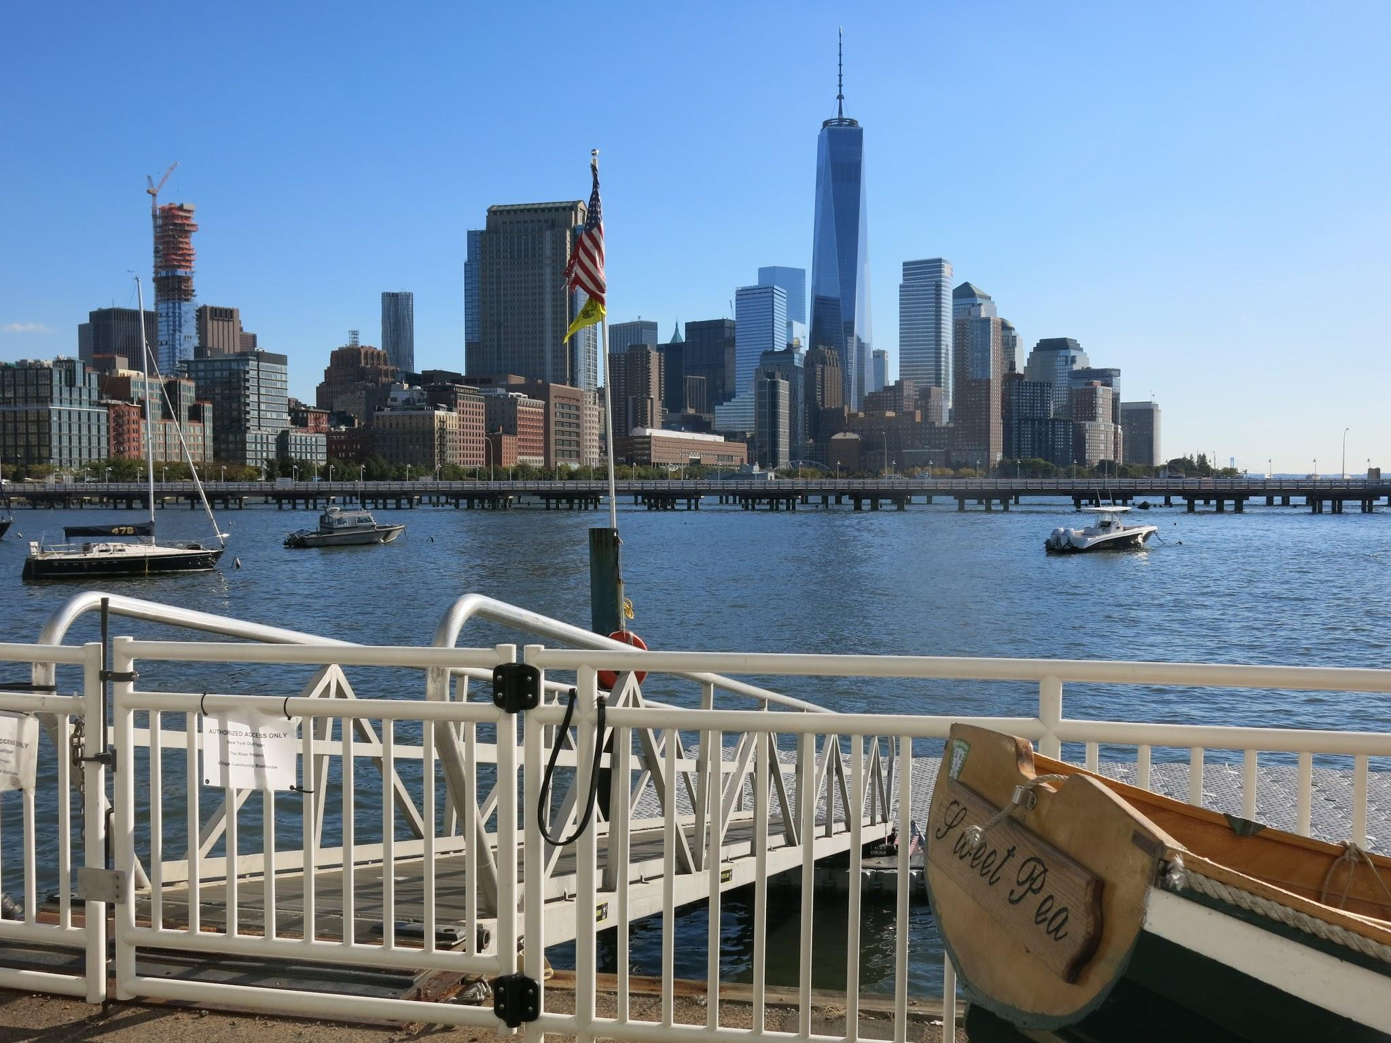
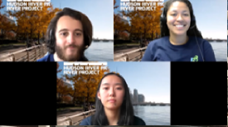
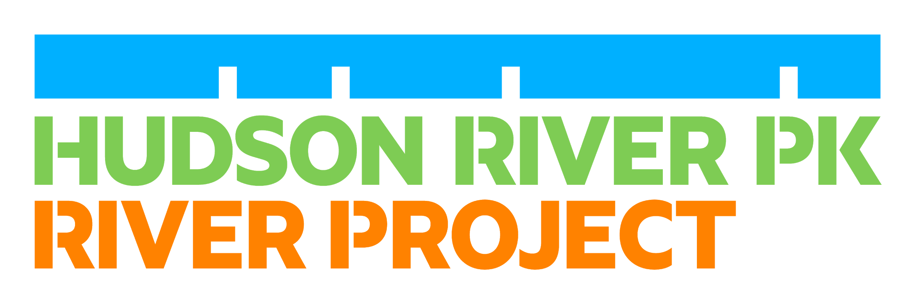
Our Living Estuary
Ctrl + click
videos on each slide to hear from Hudson River Park educators!
Notes:
Video Caption:
Hello! Welcome to our virtual Hudson River Park experience and an introduction to the Hudson River Estuary. My name is Anna!
Hi I’m Olivia!
Hi my name is Toland! We’re so happy that you’re joining us today. We are from Hudson River Park’s River Project, a team of scientists and educators that work on the this body of water. Our job is to conduct research and provide interactive education about the Hudson River Estuary to new york city students, like you!
We put together the following presentation with videos, images and guiding questions to provide you with a unique and comprehensive look into the urban ecology of the Estuary. Join us as we introduce you to native wildlife, River conditions, human impacts and everything in between!
Remember, you can always pause or repeat a slide and there will be moments where we will ask you to think about and reflect on key terms. You can also find captioning located in the notes section below each slide. Now, let’s go to the next slide to explore more of the Park!

Slide 2
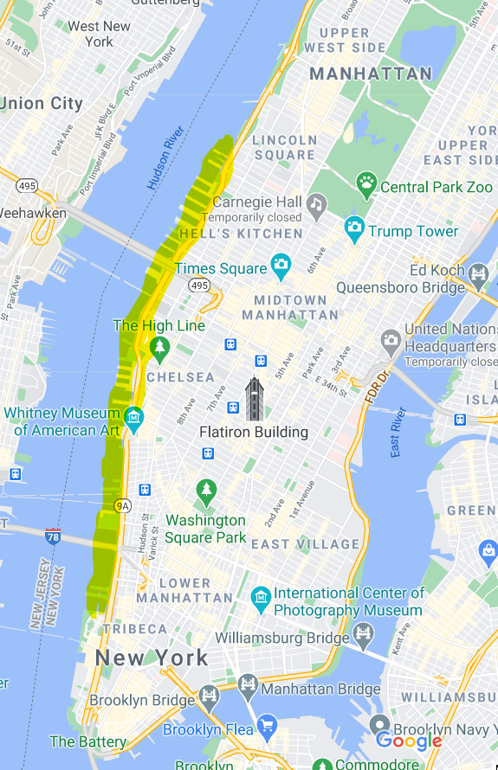
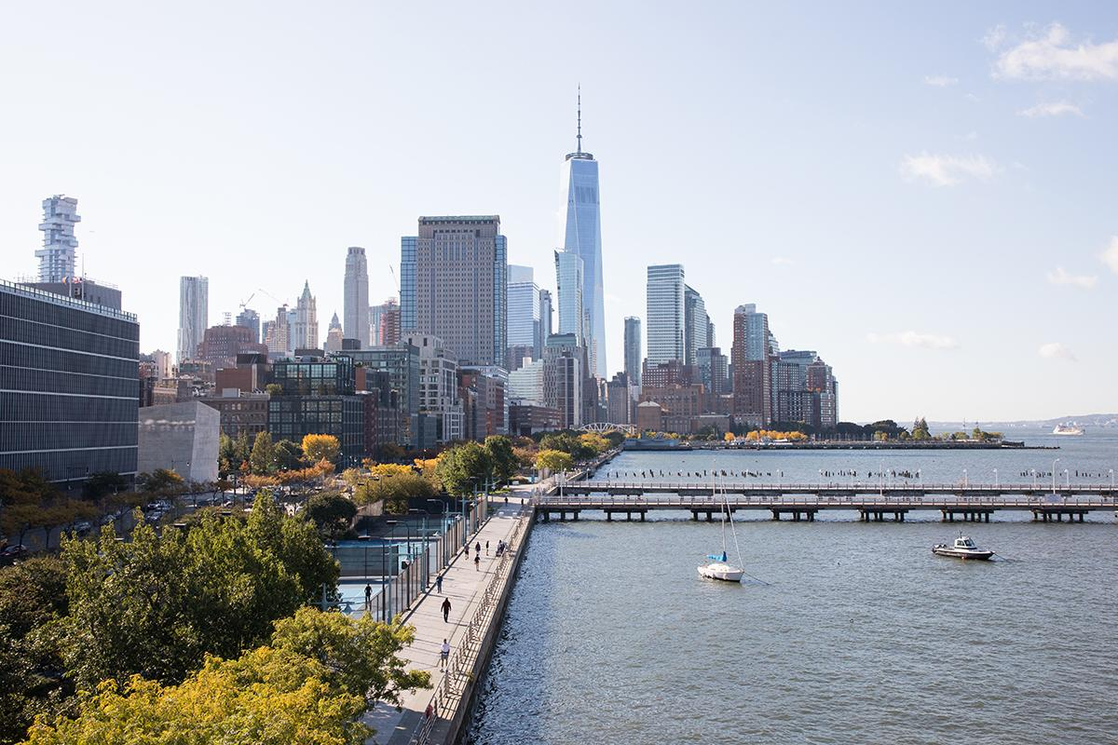
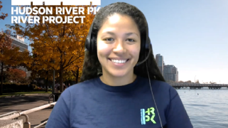
Welcome to Hudson River Park!
Hudson River Park is mostly WATER:
The Hudson River Estuary
Ecology = the study of the relationships between living organisms and their environment
Notes:
Video Caption:
All right, let's get started by introducing you to Hudson River Park! As you can see on the map to the right, we are located on the West side of Manhattan, from Chambers St to West 59th St. Much of the Park is actually water, there is 400 acres of the Estuarine Sanctuary, a protected habitat. What's also unique about our Park is the piers that provide habitat for all kinds of wildlife! This is what we will study and learn about today: the ecology of the Hudson River Estuary. Ecology is the study of the relationship between living organisms and their environment.
Click to the next slide to “Pause and Think” about an example of a habitat and what makes up an estuary.

Slide 3
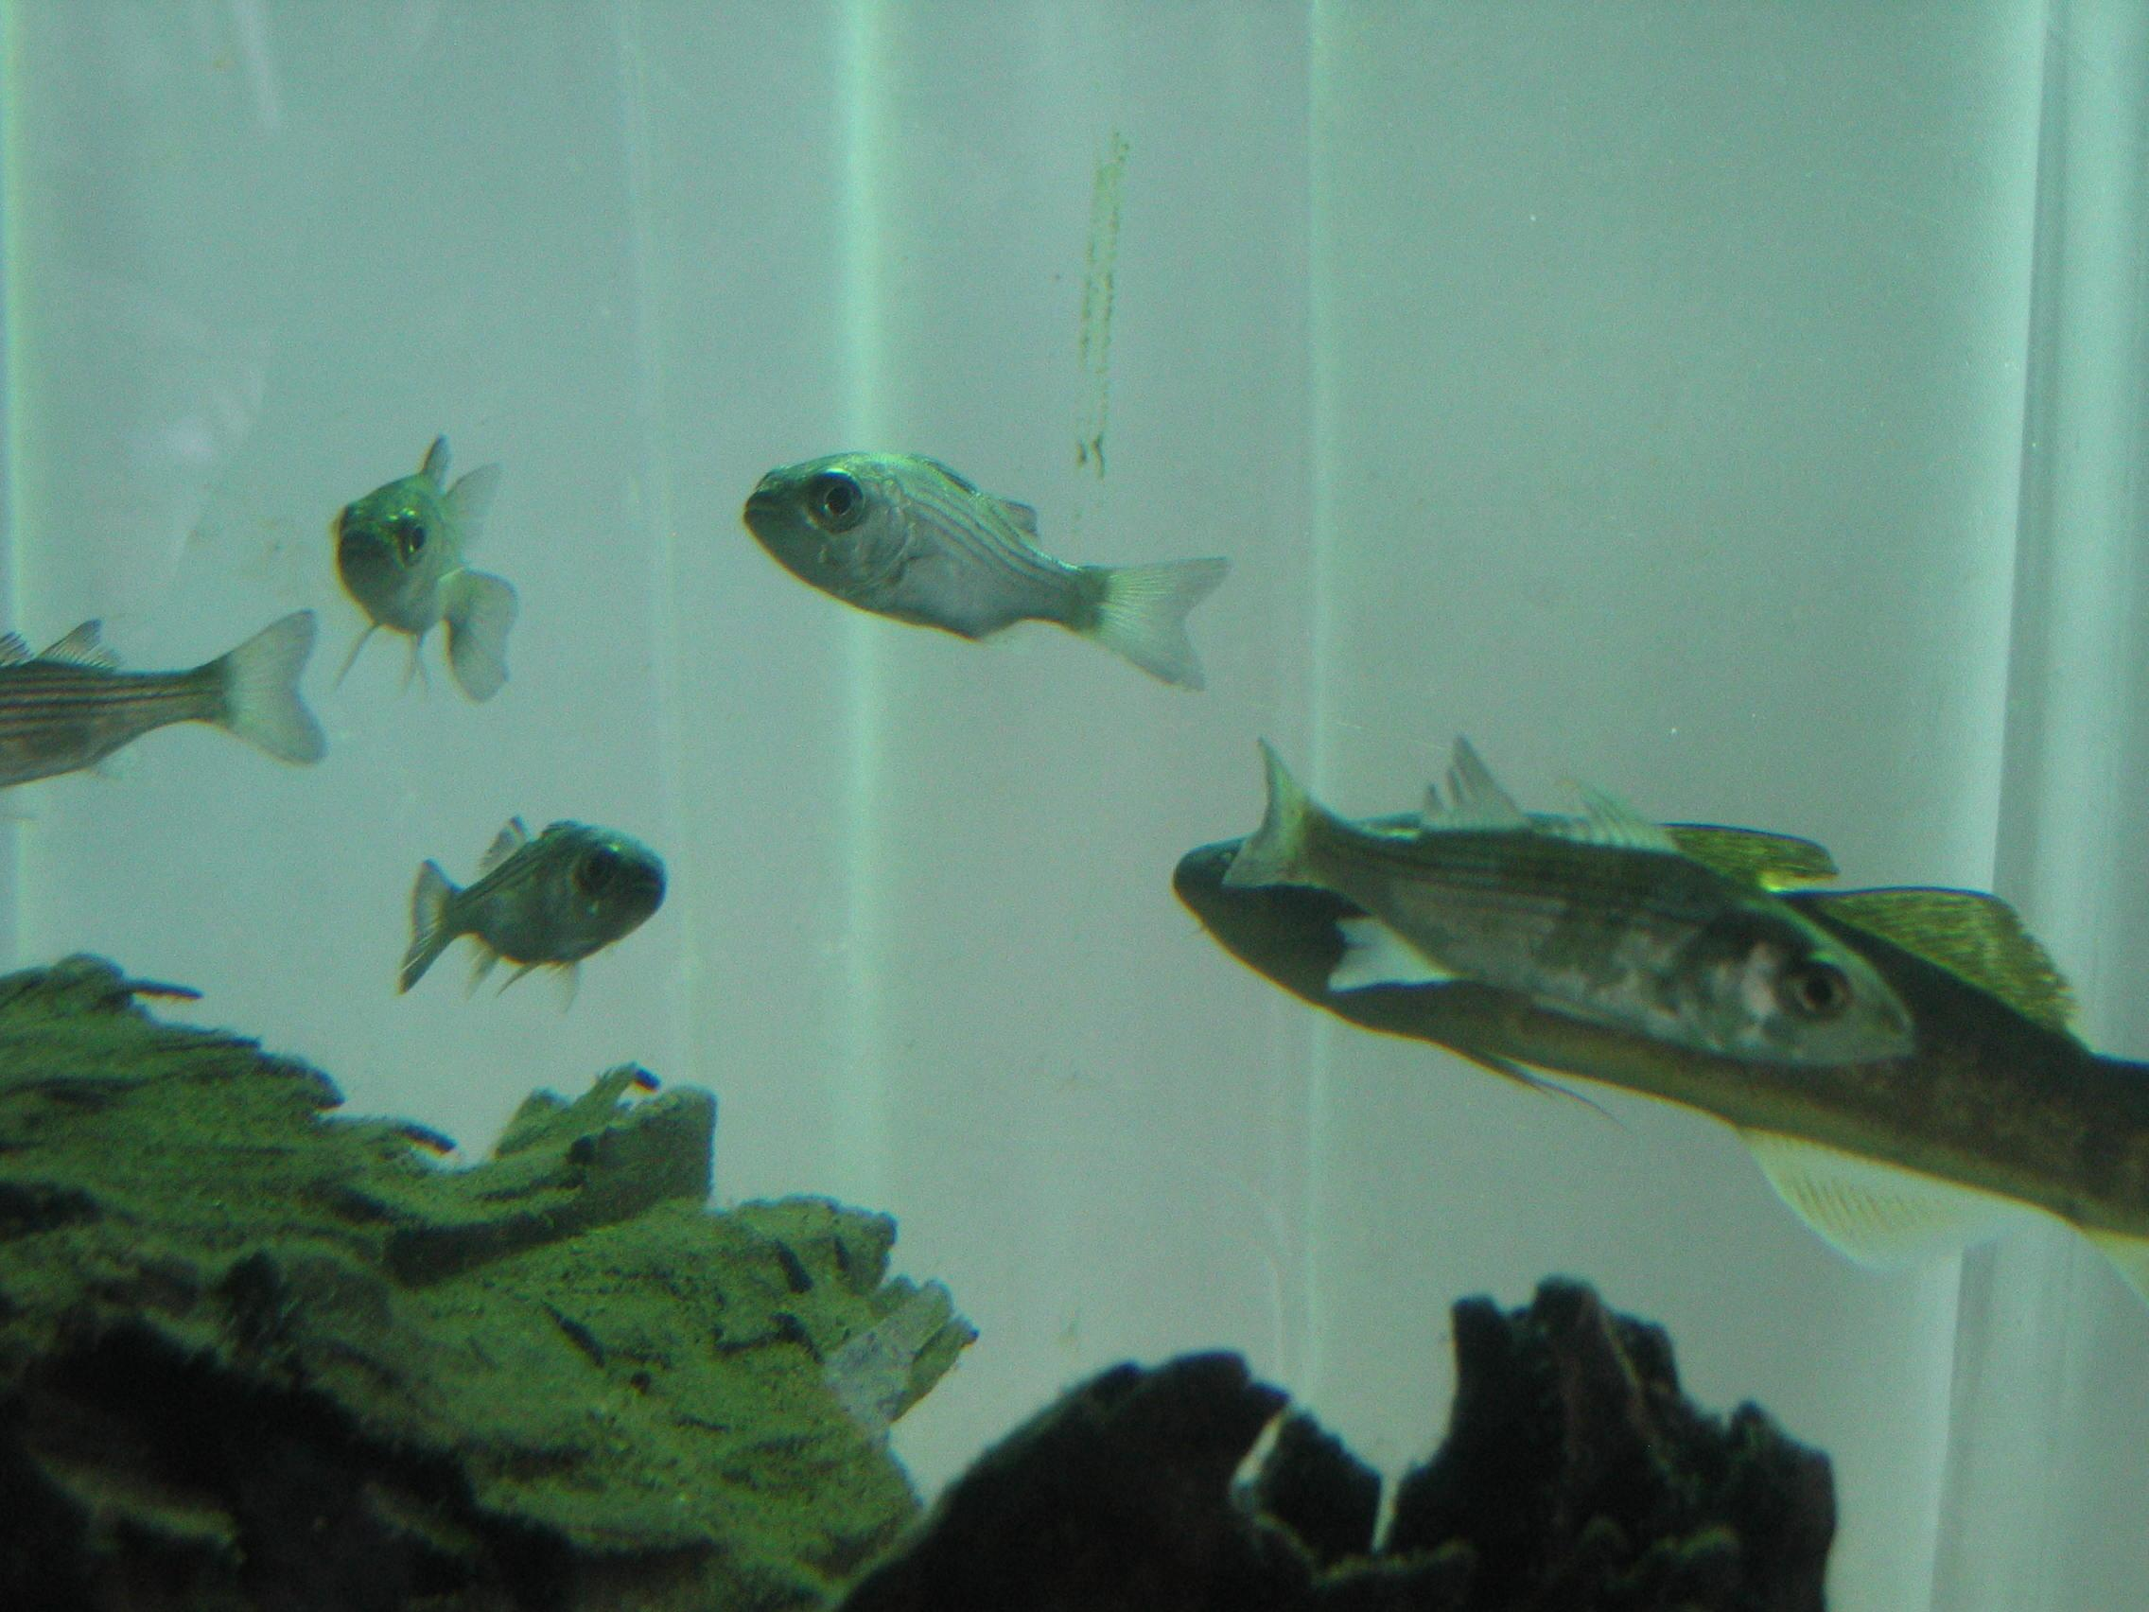
Check your knowledge!
What is a habitat?
What is an estuary?
Notes:
Answers on the next slide!

Slide 4
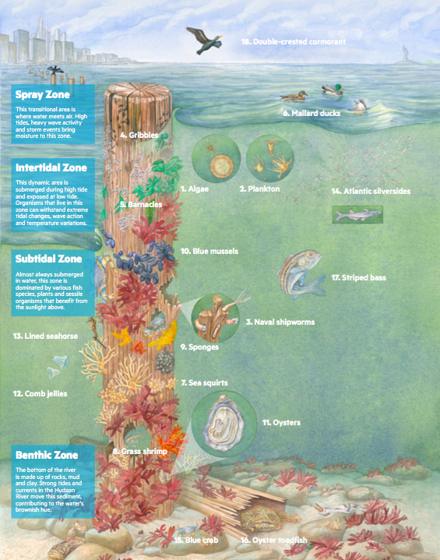
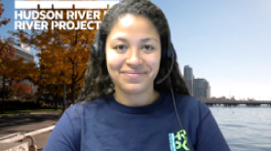
The Hudson River Estuary
Estuary = an environment where freshwater and saltwater meet (brackish water)
Habitat = a natural home of a living organism
Piles = supports that hold up a pier (in this case made of wood)
Notes:
Video Caption:
If you look at the image on the right, you can see examples of native species that pile fields are able to support under the surface of the Estuary. An Estuary is an environment where a freshwater source connects with the ocean, creating a brackish mixture as the water moves from currents and tides. Estuaries therefore are a unique, nutrient rich habitat that supports great biodiversity. Fish, birds, crustaceans, plankton and more all call this Estuary their natural home. Take a pause here to take a closer look at the image, notice the different vertical zones of the water column and see if you can identify any familiar organisms! You can also find the link to the poster in the notes below. Now, let’s travel over to Hudson River Park and explore the Estuary!
HRPK Life in the Pile Fields Poster: https://hudsonriverpark.org/app/uploads/2020/06/River-Project-HRPK-Life-In-The-Pile-Fields-2020.pdf

Slide 5
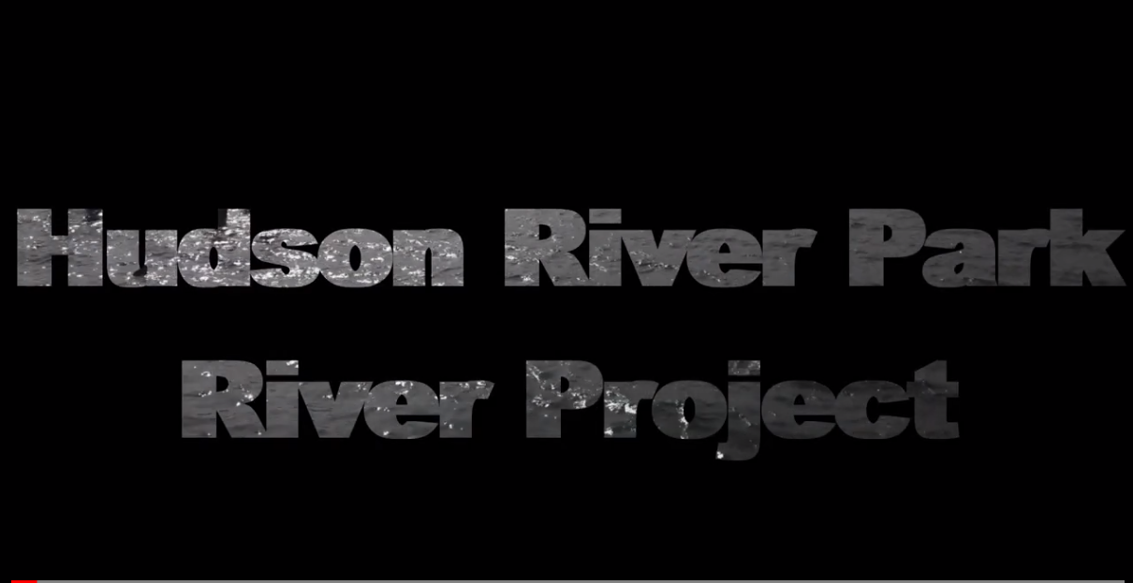
Our Tidal Estuary
Notes:
Open captions are provided within this video.

Slide 6
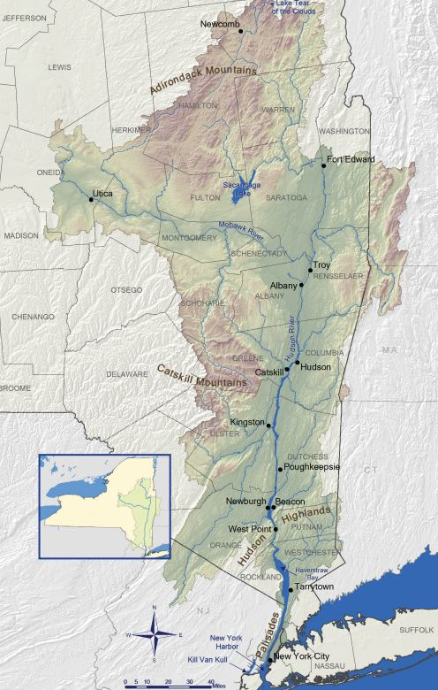
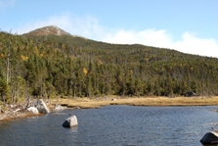
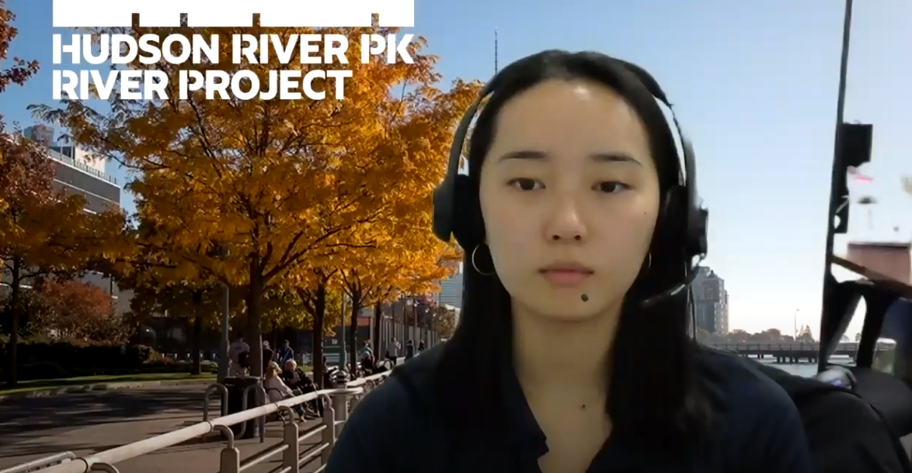
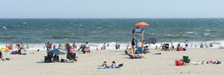
Where does the Hudson River’s water come from?
The Hudson River = 315 miles
Lake Tear of the Clouds (the source)
Atlantic Ocean (the mouth)
Notes:
Video Caption:
Let’s take a look at this map to gain a better understanding of where the Hudson River is, and how the Hudson River Estuary fits in.
This is a map of the Hudson River Watershed. This means that whenever it rains or snows in the highlighted regions of the map, that water makes its way into the Hudson River.
At the very top of the map, circled in orange, you’ll find the source (or the beginning) of the River. This is a body of freshwater called Lake Tear of the Clouds. It’s located on the highest mountain in NY State called Mount Marcy, found within the Adirondack Mountain Range.
At the bottom of the map, also circled in orange, you’ll find the mouth (or the opening) of the Hudson River. The River’s end opens into the Atlantic Ocean, which is a body of saltwater.
From the source of the Hudson River to the mouth, the River runs for 315 miles!
As we mentioned before, when freshwater and saltwater mix, we get brackish water, and this type of water creates an environment called an estuary. That’s what we have in nearly half of the Hudson River (153 miles to be more precise). That orange arrow in the middle of the map points to the city of Troy, where Troy Dam is located.
Between the mouth of the river and Troy, we have brackish water. That’s why we call this stretch of the River the Hudson River Estuary.
Let’s check your understanding with some questions on the next slide.

Slide 7
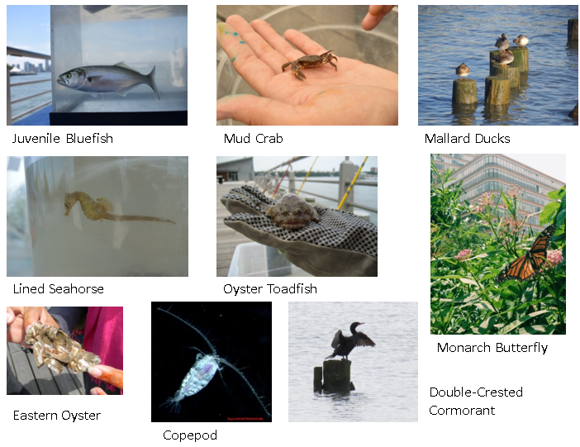

Check Your Understanding
Where is the source of the Hudson River?
What is brackish water?
Brackish water is found in what type of environment?
Next, let’s get a glimpse of what’s living in the Estuary!
Notes:
How did you do? You can always refer back to the previous slide.

Slide 8
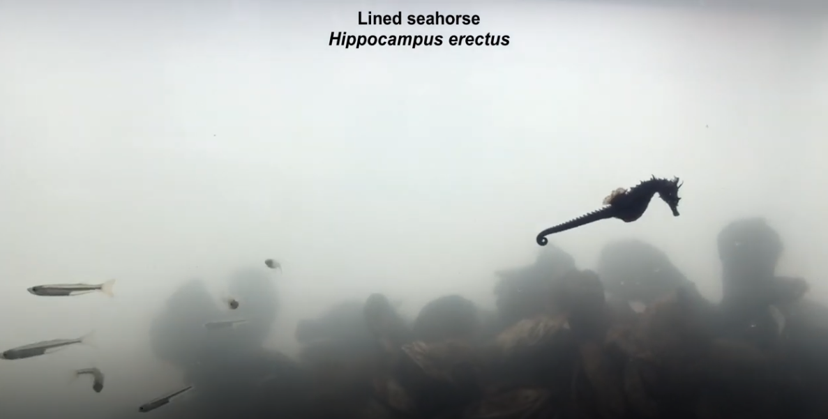
Fishes of the Estuary
Notes:
Open captions are provided within this video.

Slide 9
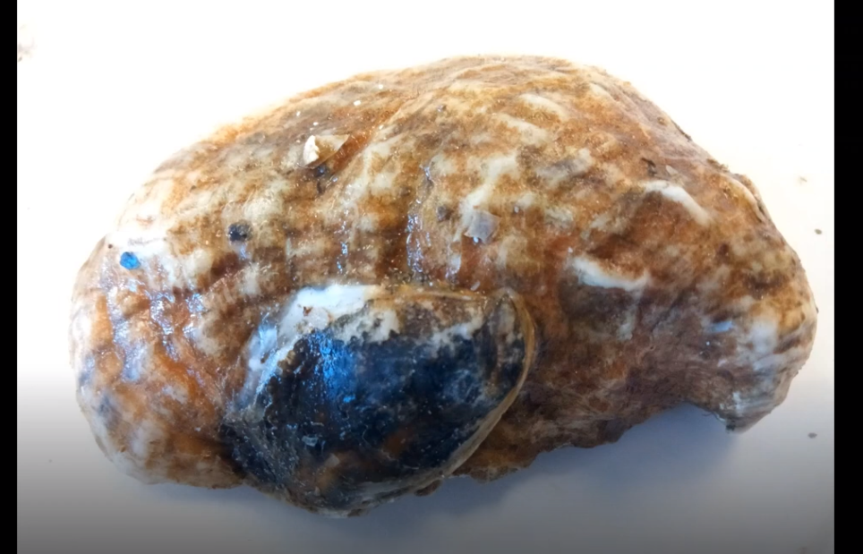
Oysters: A Keystone Species
Notes:
Open captions are provided within this video.

Slide 10
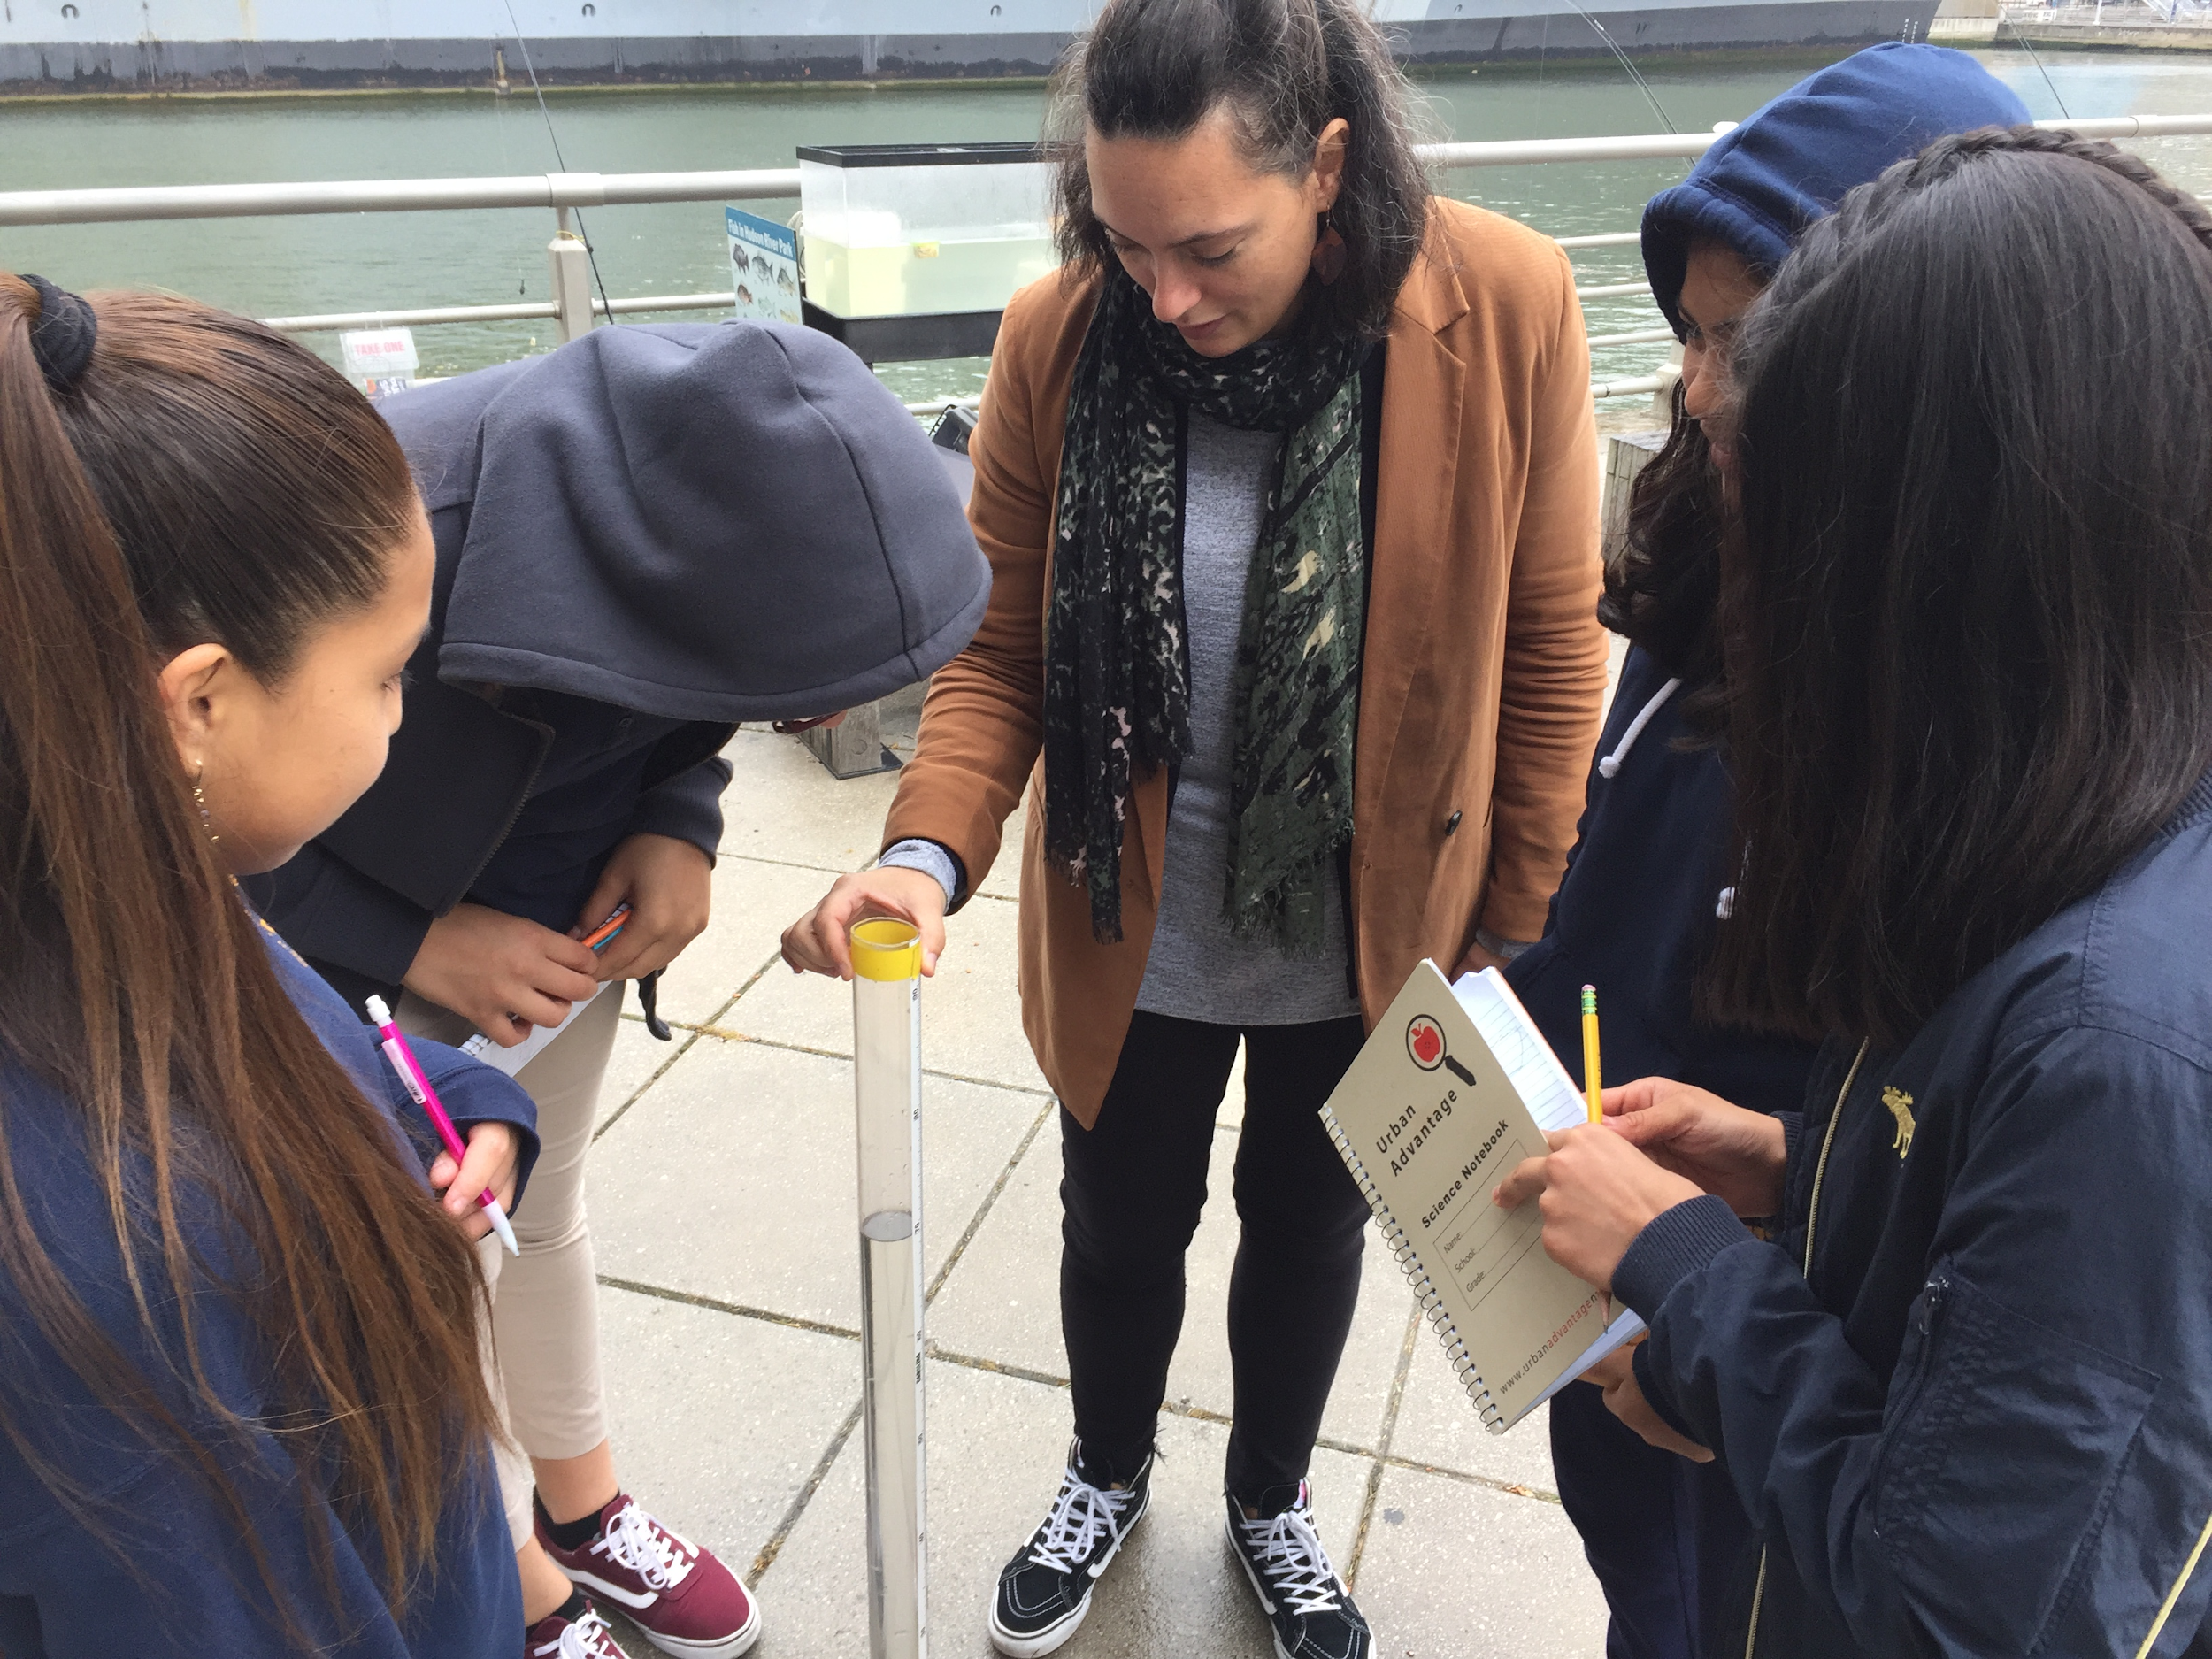
Pause & Think
Water conditions in the Estuary influence the health of wildlife.
What types of water quality would be important to measure?
Click to the next slide to measure two examples!
Notes:
There are many different water quality parameters to consider! Go to https://www.hrecos.org/ to check out current conditions on the Hudson River.

Slide 11
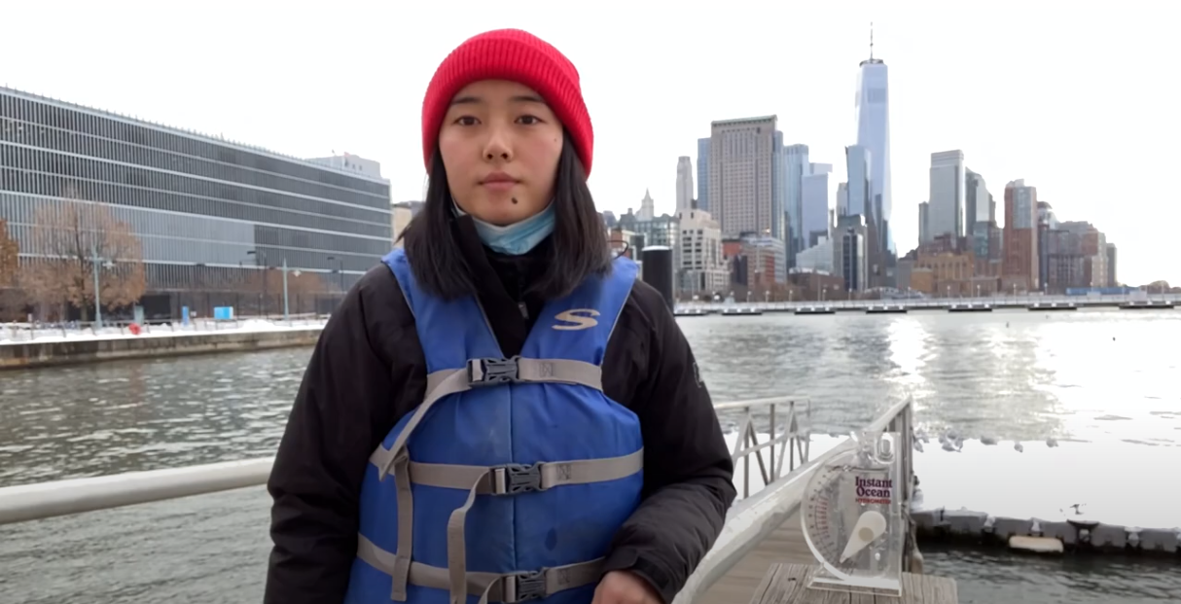
Testing Water Quality
Notes:
Open captions are provided within this video.

Slide 12
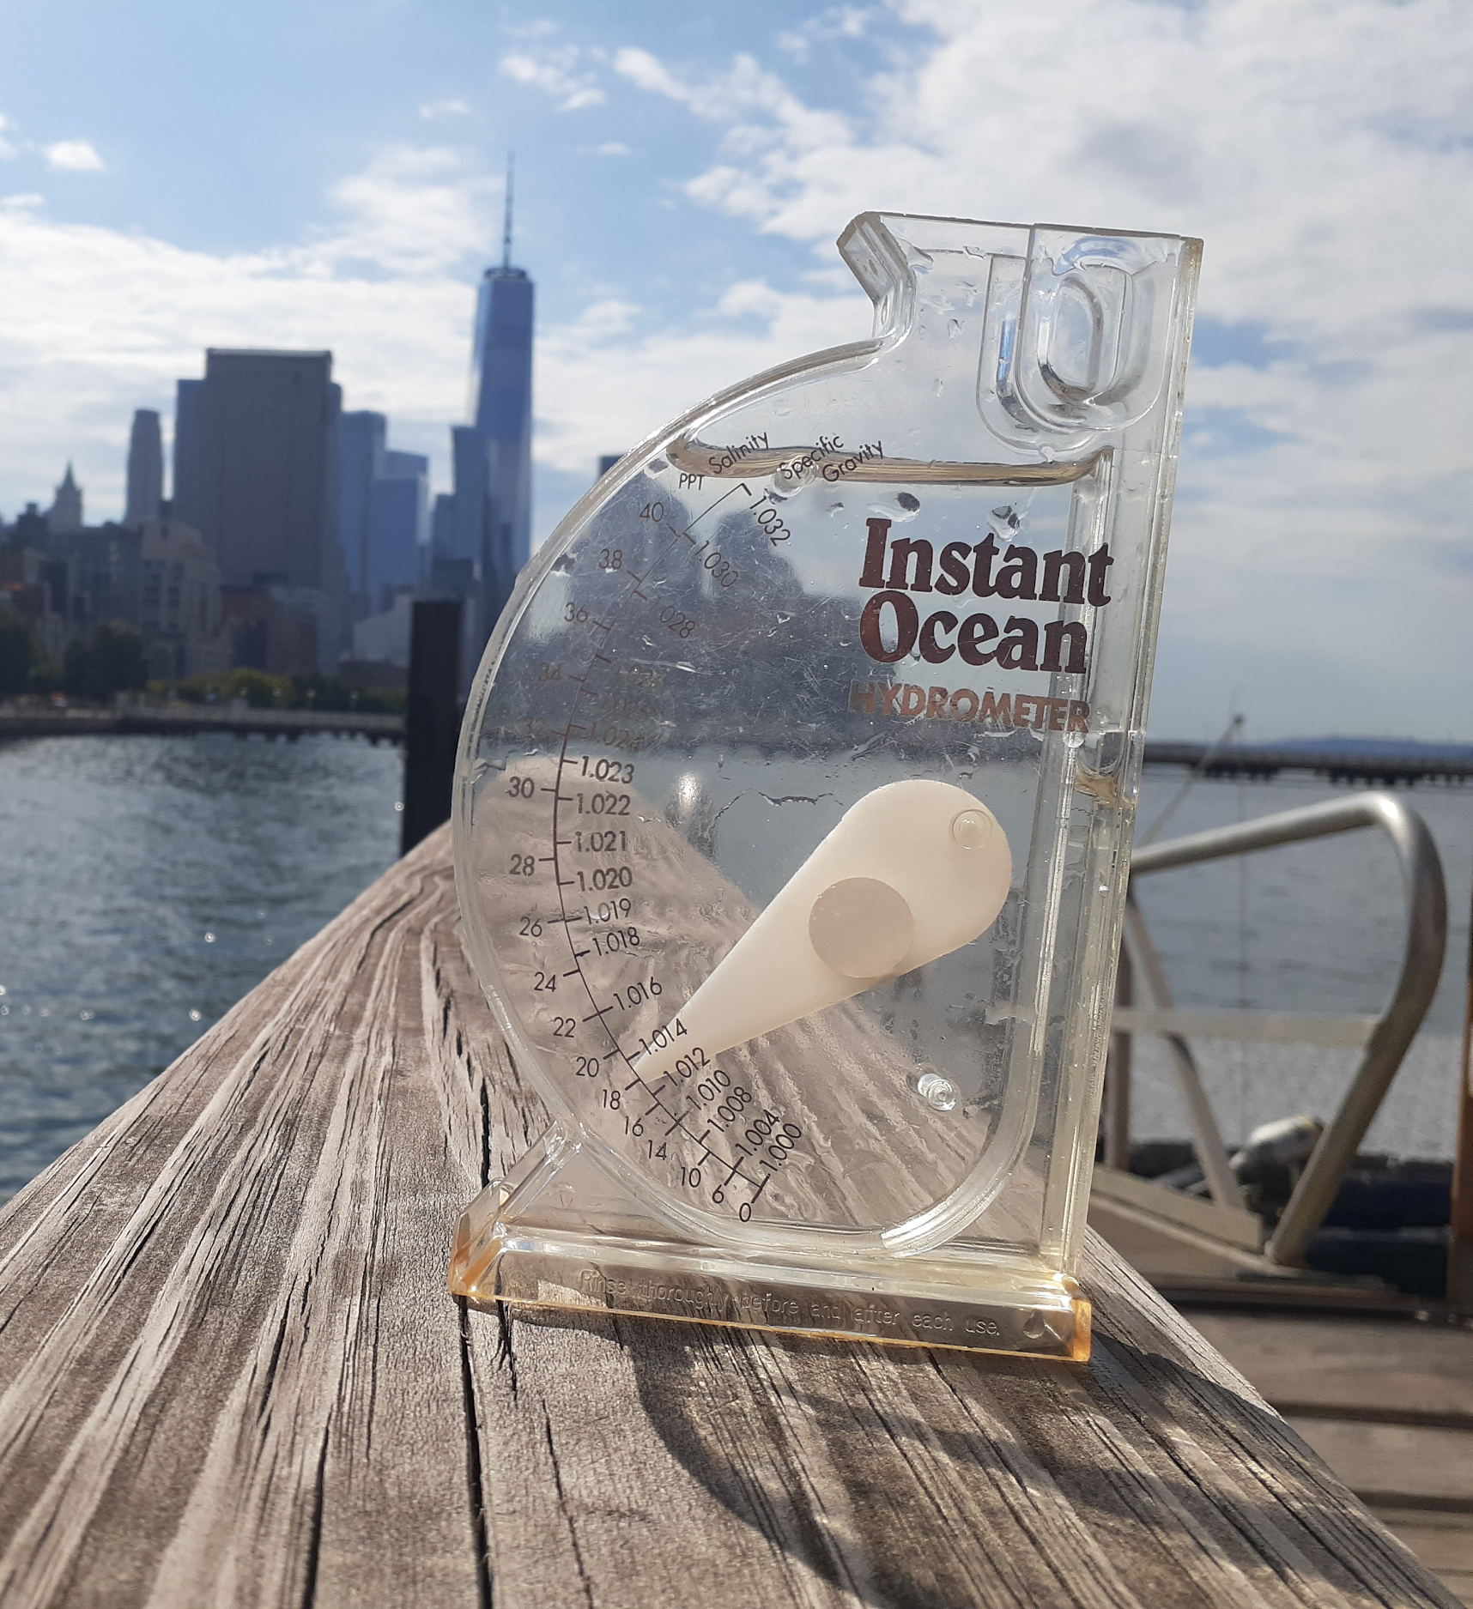
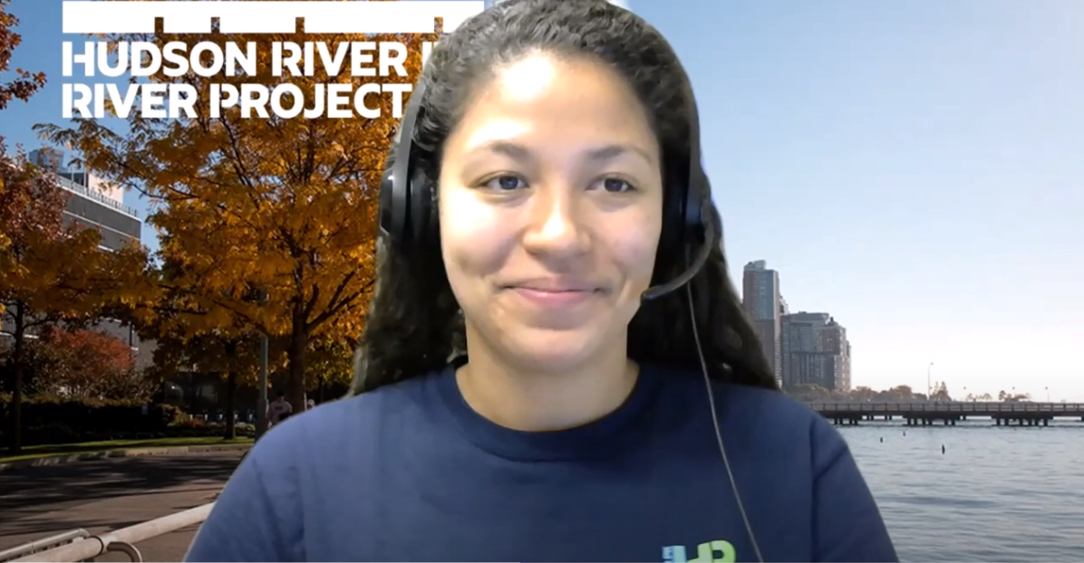
Check Your Understanding
Salinity is a measurement of which element of water quality?
Notes:
Video Caption:
Let’s check your understanding, what is salinity a measurement of? Well, it’s the amount of salt dissolved in water and since the Estuary is brackish, we will always see some level of salinity. If you remember, Olivia showed us how to measure salinity using a hydrometer, pictured here on the right, which measures salinity in a liquid through density. Density is about how closely packed the molecules of a substance are. Water with salt is going to be more dense than freshwater because salt molecules have been dissolved into the same amount water. Brackish water salinity is somewhere in between the salinity of freshwater areas and the ocean and can increase or decrease depending on the season, weather and other factors.
We’re going to now visit Toland and his microscope to take a look closer look at a single drop of that brackish water.

Slide 13
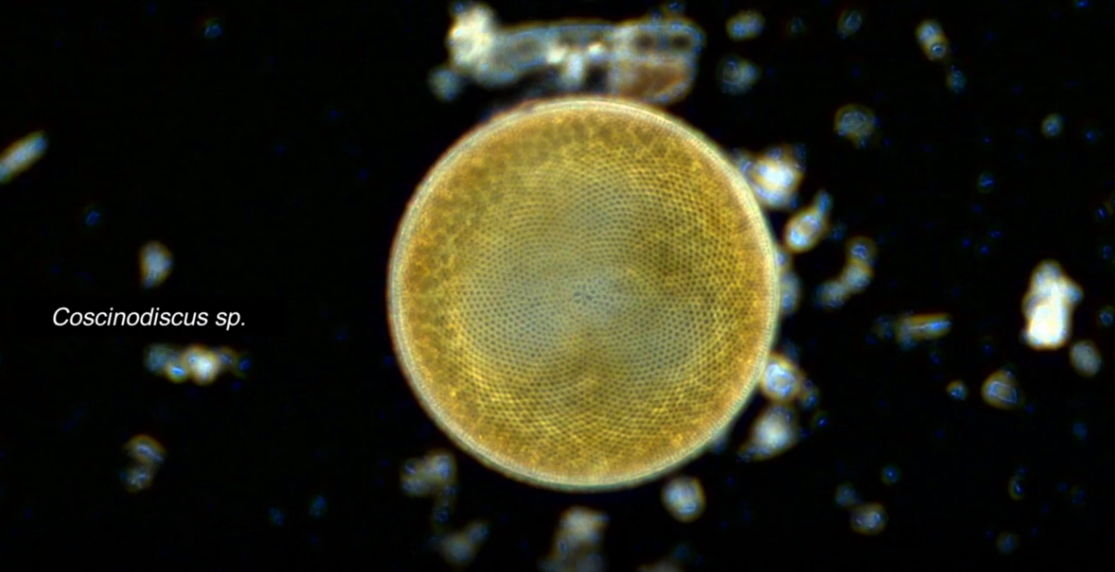
Plankton
Notes:
Open captions are provided within this video.

Slide 14
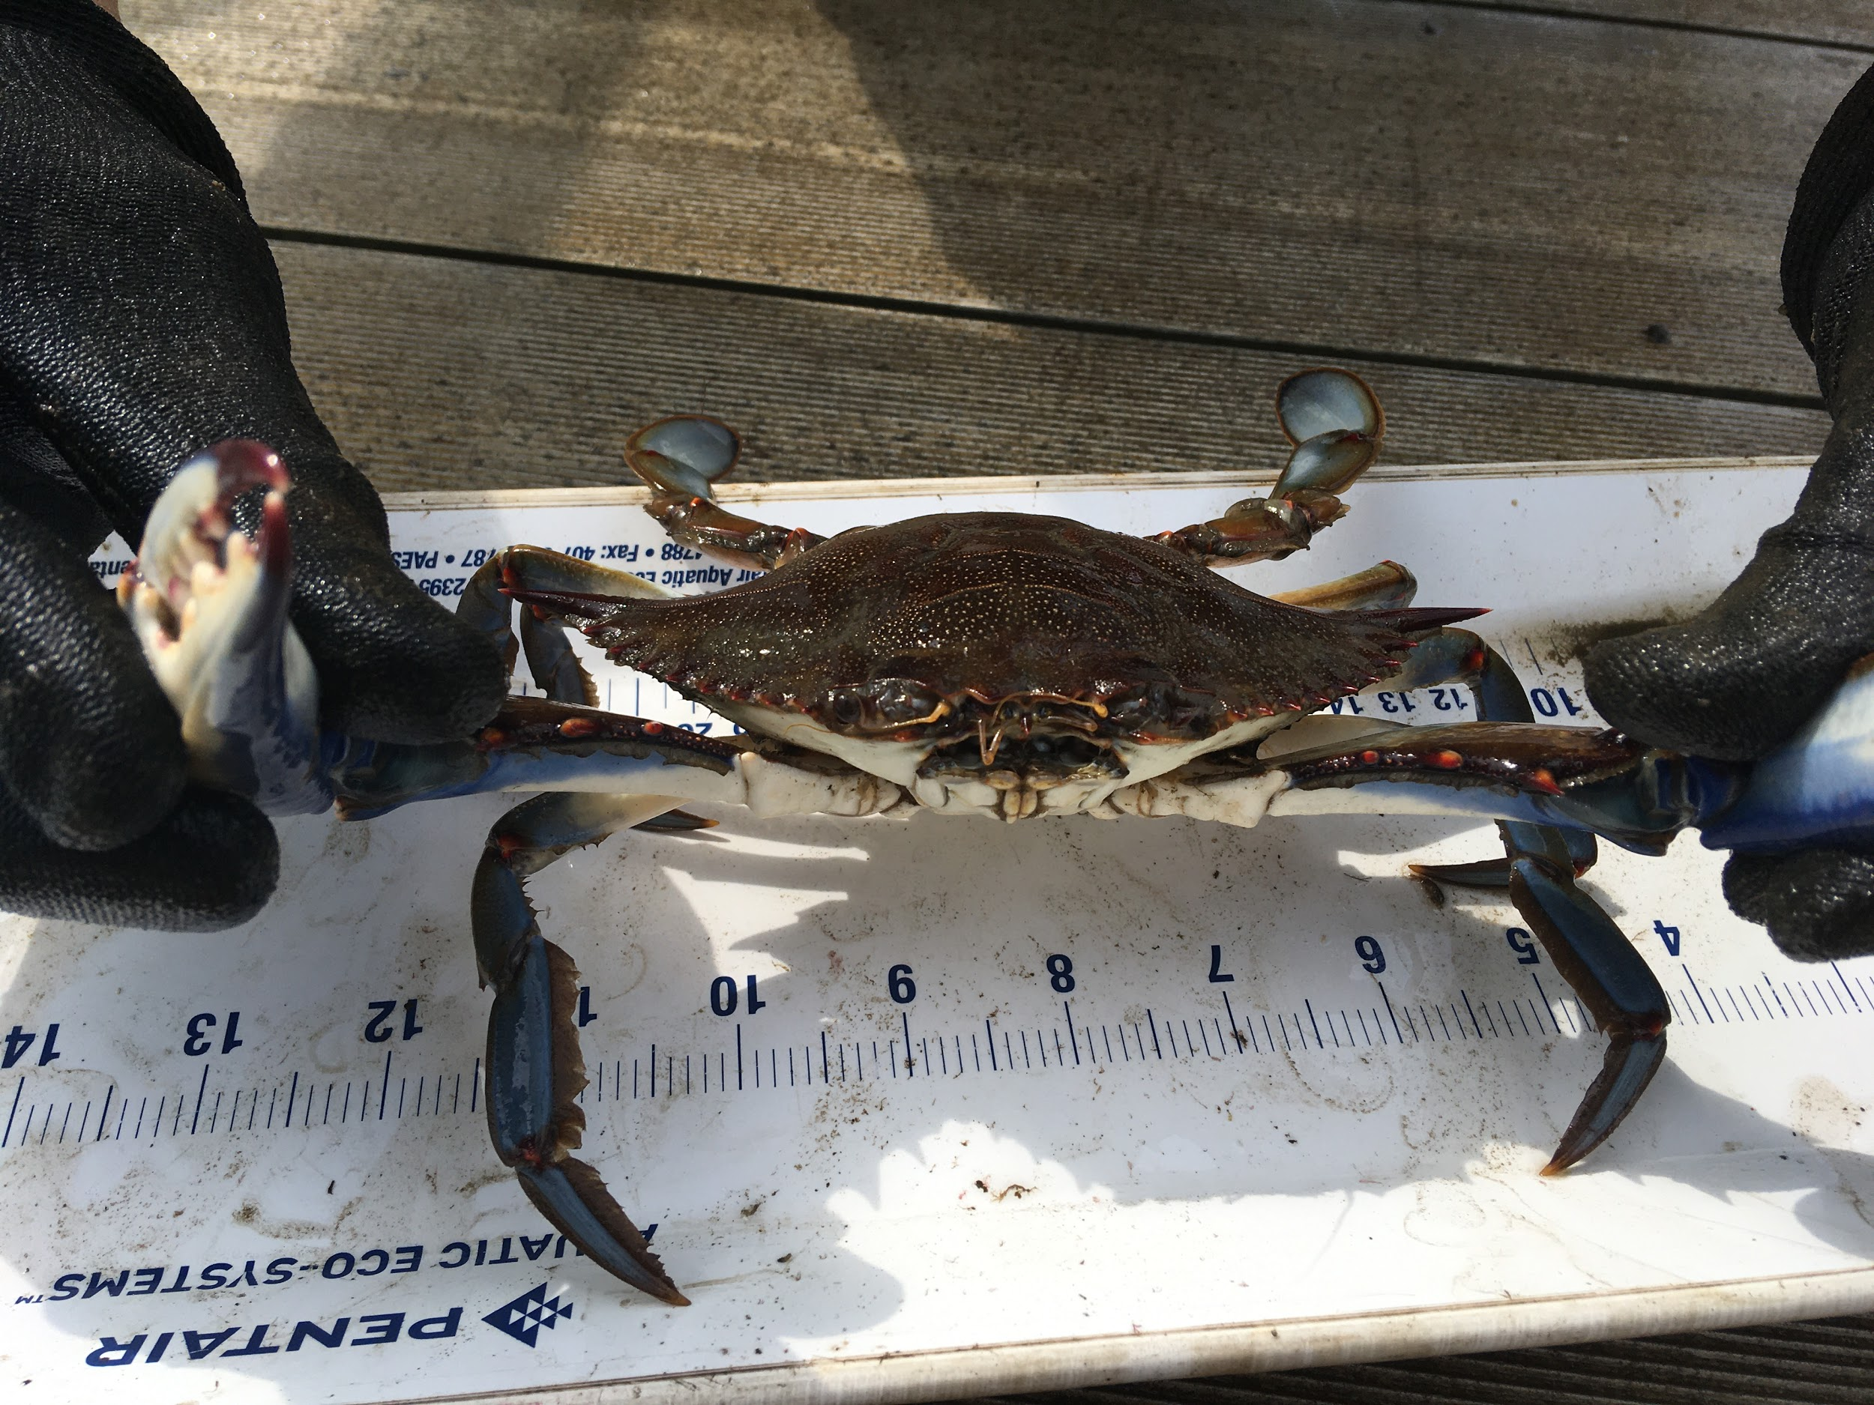
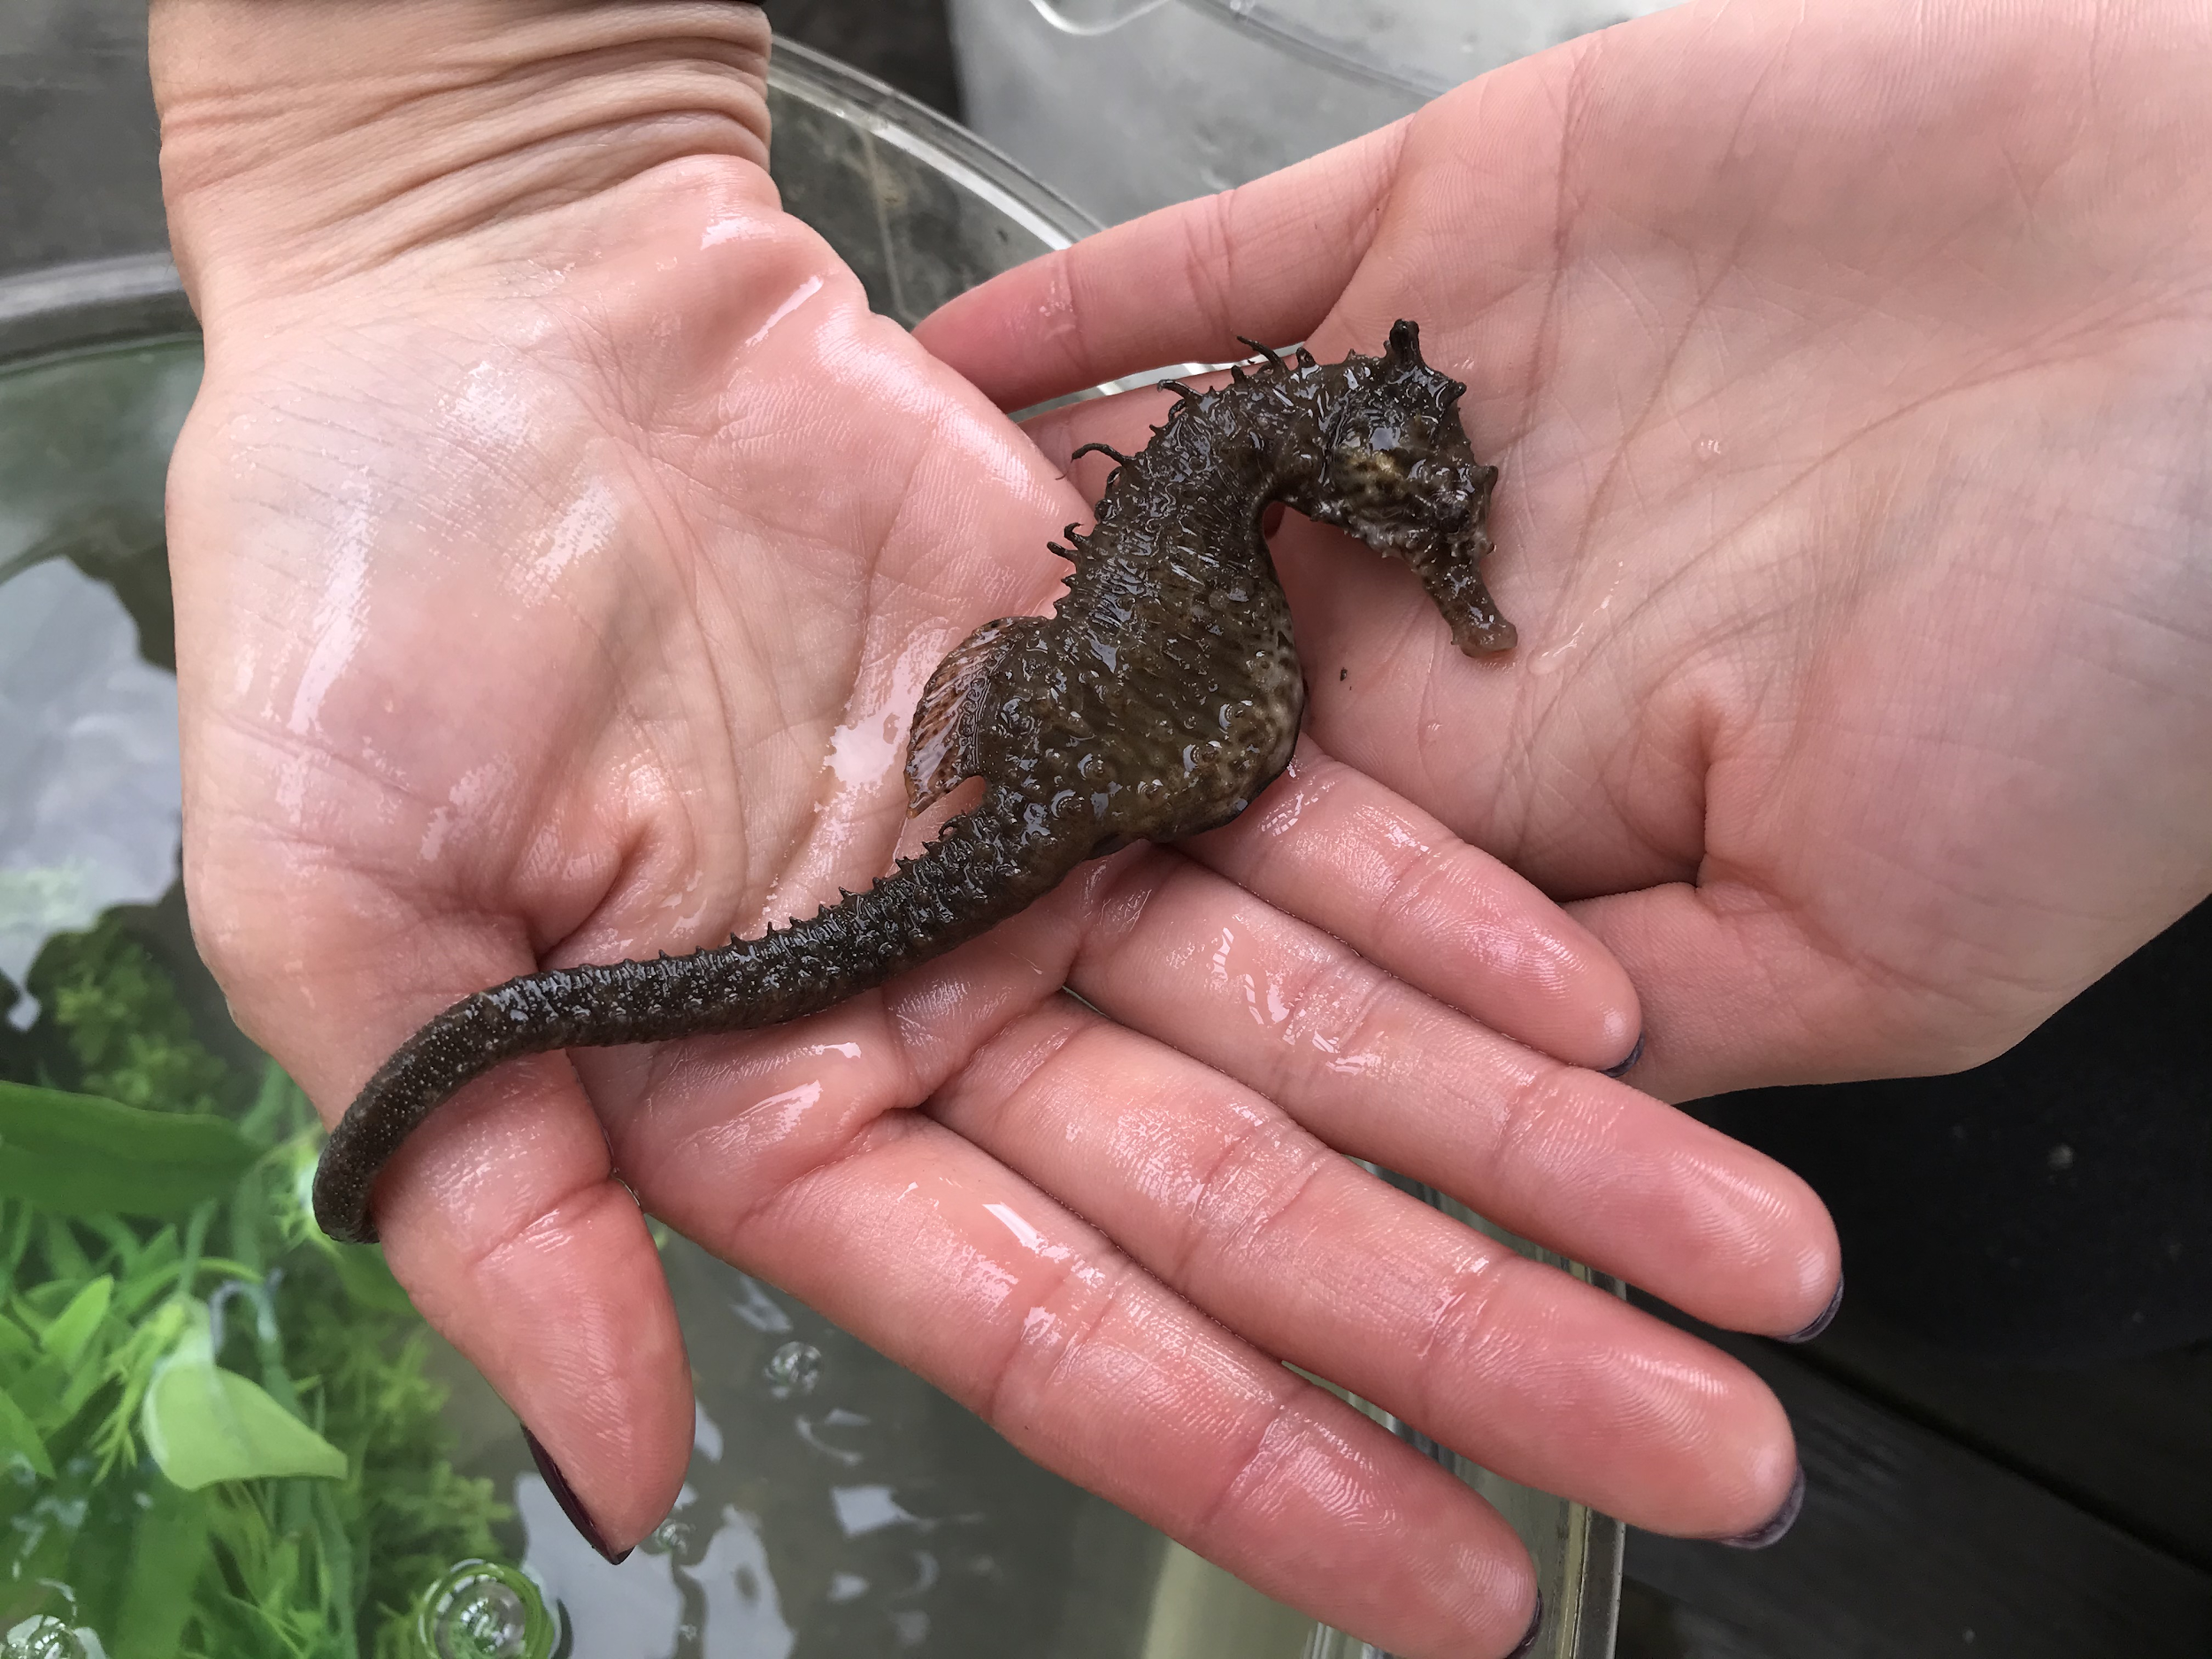
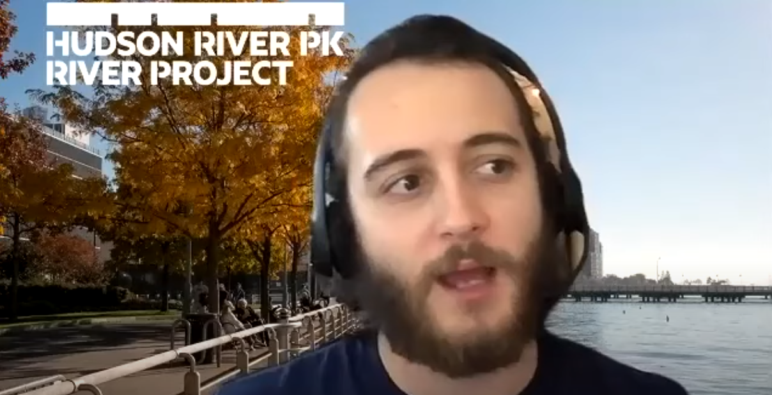
Changing Waters
Water conditions can influence:
Organism health
Migration and spawning patterns
Other water conditions
And more!
Click here to see real-time Hudson River conditions at different points along the River.
Notes:
Video Caption:
An estuary is a biodiverse environment that supports a variety of living organisms. In addition to food sources and habitat, estuaries offer a range of water conditions that support different species. As seasons change, the conditions in the water change too, so we usually see different species at different times of year. When the River’s salinity increases, we are more likely to see marine (ocean dwelling) species that can tolerate higher salt concentrations. In the winter and spring when the salinity is low, we are more likely to see freshwater species that cannot live in salty water. Other factors like pollution and temperature changes also influence wildlife present in the Estuary. For example, blue crabs are active during the summer when the water is warm, but they hibernate during the winter when the water becomes cold. On the other hand, when seahorses in the river start to get too cold, they migrate out of the Estuary to deeper, warmer waters.
As Hudson River scientists, we test a variety of water quality conditions including temperature, dissolved oxygen, turbidity and salinity. You can check out real-time Hudson River conditions by clicking on the link that’s on this slide here.
Now let’s take a second to pause and take a second to think: What other factors can influence the health of the Estuary?

Slide 15
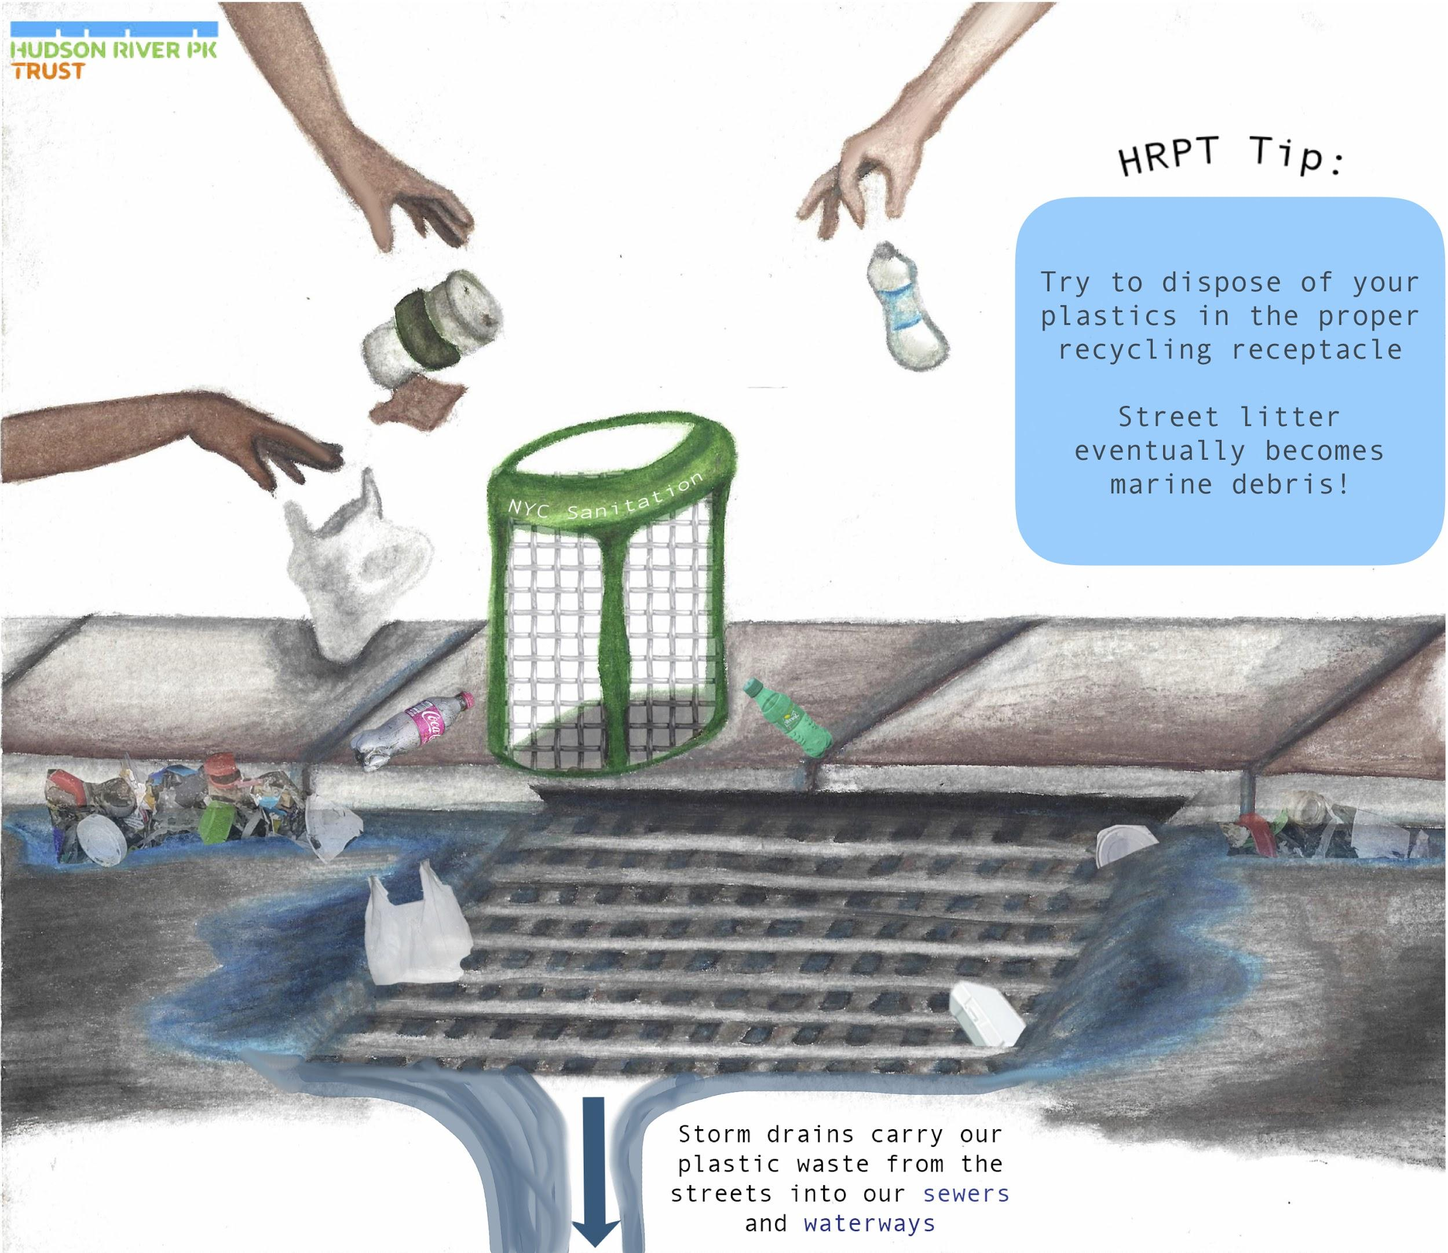
Pause & Think
What other factors can influence the health of the Estuary?
Illustration by Gemma Petrini
NYU student
Instructor Clarisa Diaz
Notes:
Let’s talk about human impacts on the next slide!

Slide 16
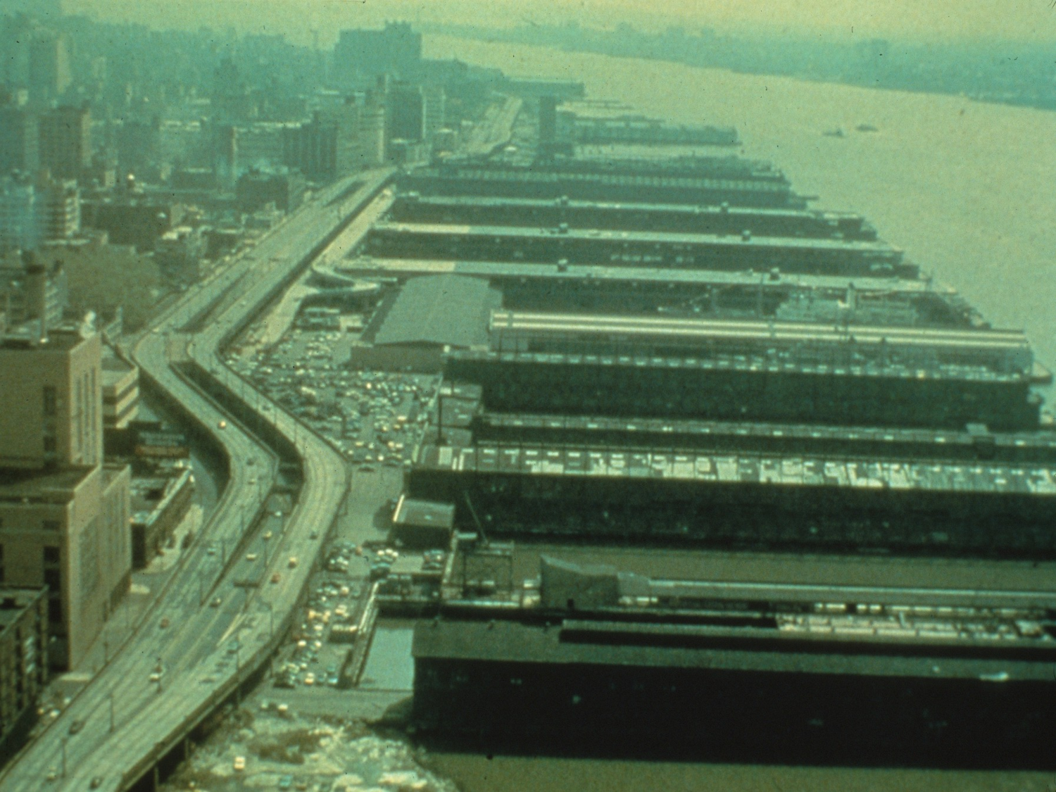
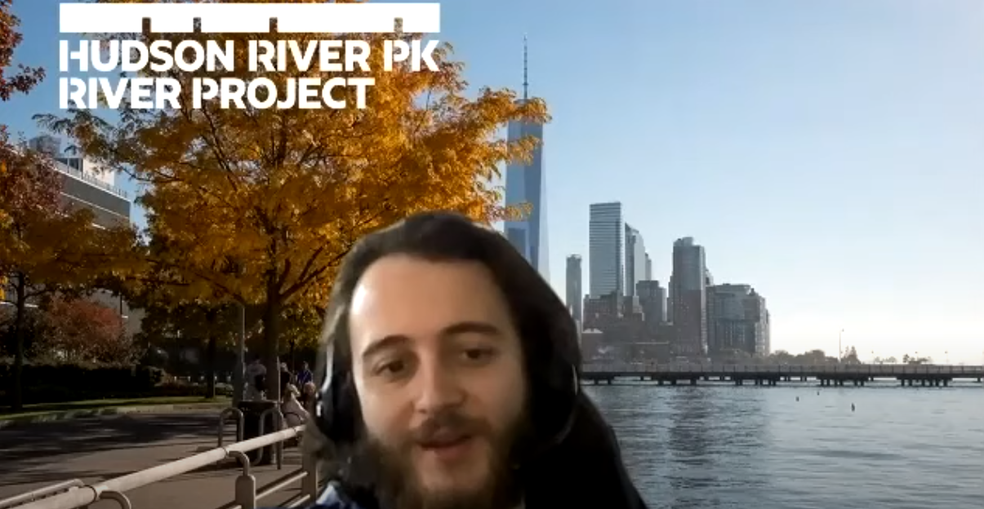
Urban Waterways
What do you see in this picture that might impact living organisms in the Hudson River?
Notes:
Video Caption:
Here, we see an image of the Elevated West Side Highway in the early 1970s before it collapsed. Believe it or not, this is what Hudson River Park used to look like. In this picture we can see some of the ways that this local shoreline and human activities might have been affecting the River. For example, we can see that this shoreline was basically one big highway. That means that some of the pollution we usually see on highways, like oil from cars or litter, might find their way into the River. We can also see lots of shipping piers reaching out from the city into the water, which could potentially impact available habitat in the River for certain species, especially as boats move in and out of the area. Another big thing that we can notice in this photo is that the air looks really funky: it has this gray, greenish, yellowish color to it. That is because air pollution was so bad at the time, you could see it. Even though this smog might not go directly into the water, this level of air pollution, as well as emissions of greenhouse gases, can still have big effects on aquatic environments.

Slide 17
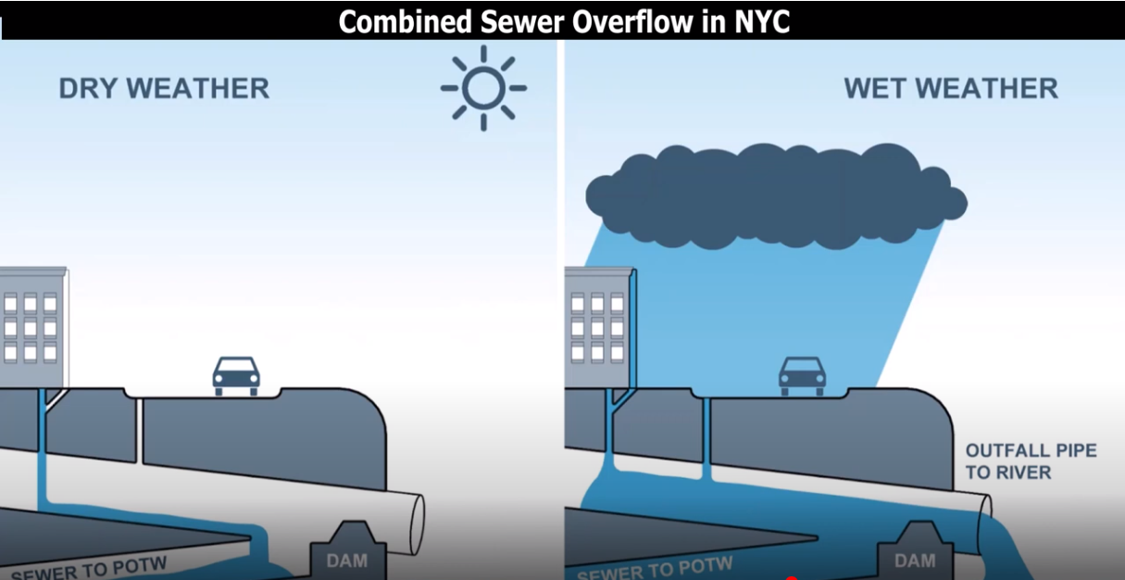
Estuary Health
Notes:
Open captions are provided within this video.

Slide 18
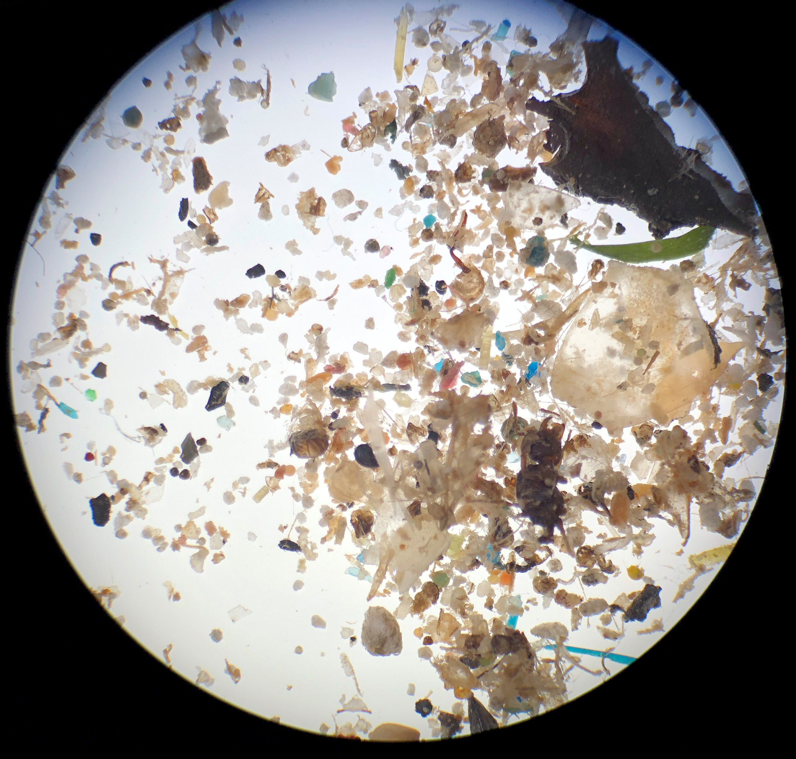
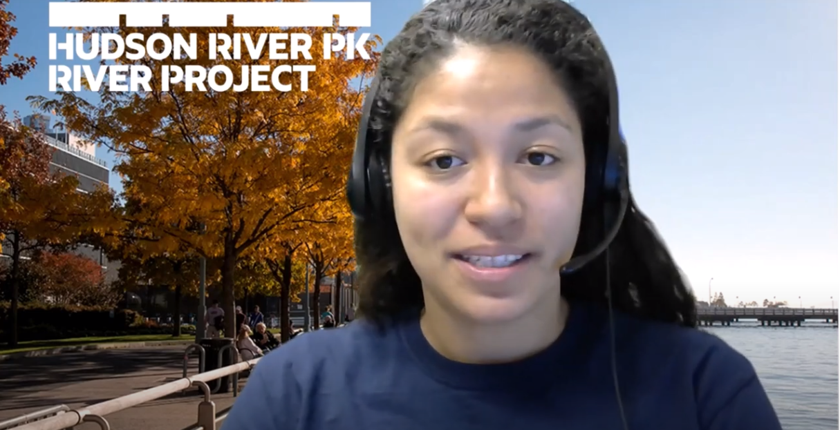
Research and Protection
River Conditions
Oyster Restoration
Pathogens
Plastic Pollution
Fish Ecology
Click here to view Park research and data!
Microplastics sample from the Hudson River.
Notes:
Video Caption:
Hudson River Park’s River Project works to restore Estuary habitat through a number of different research projects, some of which we shared with you in this presentation. We involve the community in monitoring water quality, marine debris and other variables in urban ecology in order to help inform policies that protect and restore wildlife and natural resources on local and national levels. We look forward to meeting you soon so that we can share more of the science within the River and take a deeper dive into some of the topics that we talked about today. On the next slide, you’ll find questions that you can answer either by yourself or with your group to reflect on your impact on the Hudson River.

Slide 19
Reflection
What was something surprising or new that you learned?
What do you want to learn more about?
How do you affect the environment around you?
What can you do to support healthier waterways?
Notes:
Share your reflection with us! Email your group’s thoughts to: education@hrpt.ny.gov

Slide 20
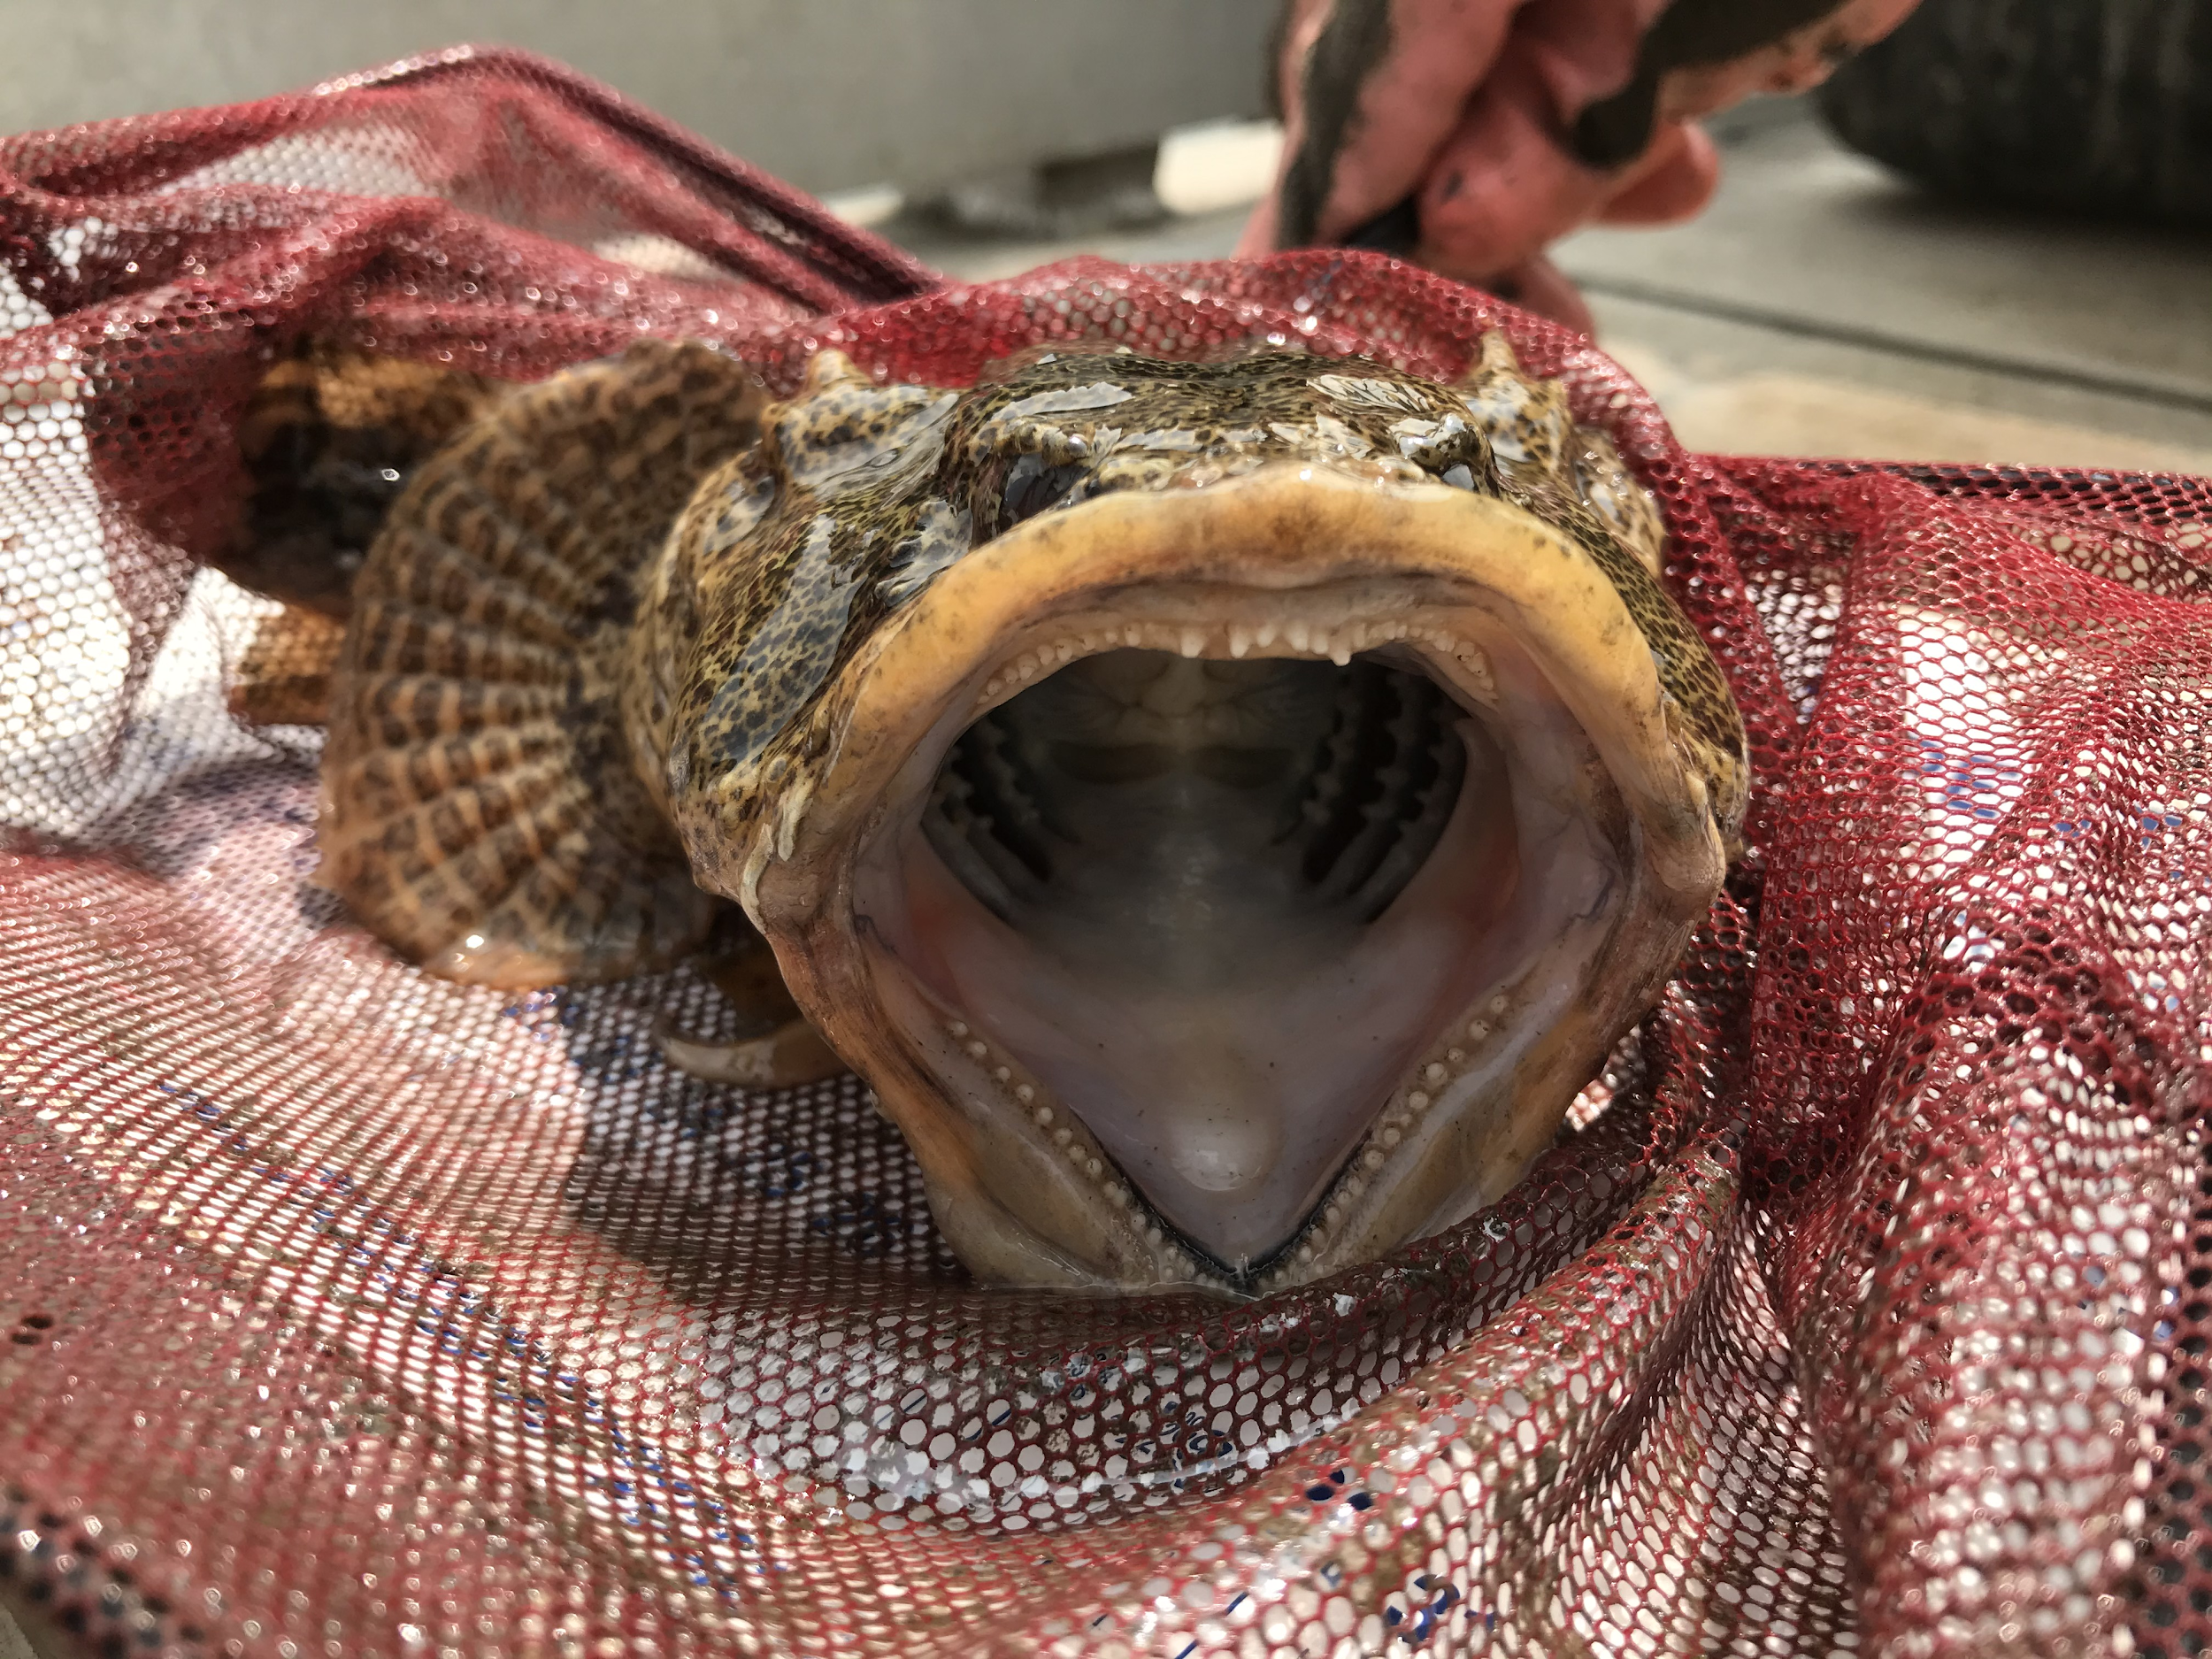
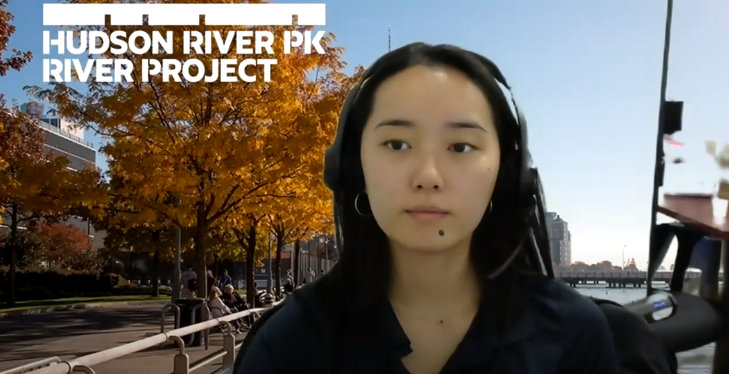



Discover More at HRPK!
Click here to Explore our virtual Wetlab aquarium.
Click here to Learn about water quality in the Hudson River Estuary.
Tell us what you thought of this presentation here!
Follow us @HudsonRiverPark
Notes:
Video Caption:
Thanks for clicking through this with us! We hope this gives you some good background knowledge about the Hudson River. Feel free to write down any questions you have, and we’ll do our best to answer them when we meet for our virtual field trip. For more information about Hudson River Park and the Hudson River, click “Explore” and “Learn” on this slide.
Please click the “survey” link to let us know how what you thought. We look forward to meeting you all virtually soon!

